Slide 1
Azure Kubernetes Service AGIC Ingress - 30 Real-World Demos
Kalyan Reddy Daida

Slide 2

AWS EKS Kubernetes
Jenkins
Azure Kubernetes Service
AGIC Ingress
30+ Real-World Demos
Ansible
Azure AKS Kubernetes
HELM Masterclass
40+ Concept Demos
Azure Certs
AZ-900, 104, 204, 400
DevOps &
SRE
Roadmap
AWS ECS
Docker on AWS
Kubernetes Certifications
CKAD, CKA, CKS
Google Cloud
Associate & Professional Certs
AWS
CloudFormation
HashiCorp Certified Terraform Associate on AWS with 50 Practical Demos
Terraform on AWS with SRE and IaC DevOps with 20 Real-World Demos
HashiCorp Certified Terraform Associate on Azure with 75 Practical Demos
Terraform on Azure with IaC DevOps SRE with 25 Real-World Demos
Terraform on AWS EKS Elastic Kubernetes Service with 50+ Real-World Demos
Google Kubernetes Engine with DevOps - 75+ Real-World Demos
LIVE

Slide 3
Google Cloud Certifications
Road Map
Google Cloud Real-World
Courses Road Map
Digital Cloud Leader
GKE Google Kubernetes Engine with DevOps - 75+ Real-World Demos
Associate Cloud Engineer
Terraform on Google Cloud
with DevOps SRE - 50+ Real-World Demos
Professional Cloud Architect
AWS EKS Kubernetes
Professional Cloud Developer
Azure AKS Kubernetes
Professional Cloud DevOps Engineer
AWS ECS Docker on AWS
Professional Cloud Network Engineer
Terraform on AWS Cloud
Professional Cloud Security Engineer
Terraform on Azure Cloud
Professional Cloud Data Engineer
Terraform on AWS EKS
LIVE

Slide 4
Azure Kubernetes Service AGIC Ingress - 30 Real-World Demos
Kalyan Reddy Daida

Slide 5
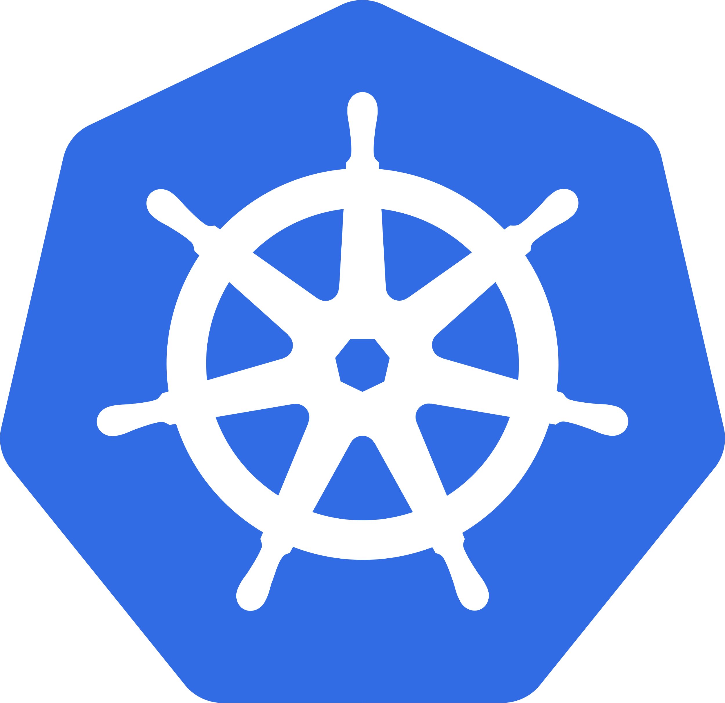




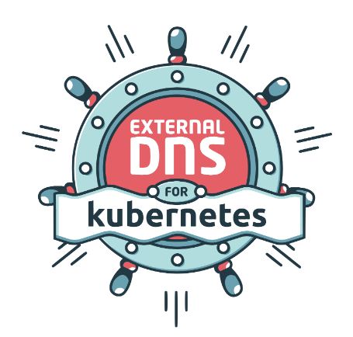


Azure Kubernetes Service + Application Gateway Ingress Controller
Azure
Application
Gateway
Ingress
Controller
AGIC
Install AGIC as
AKS Add-On
1
8
Ingress Override Frontend Port
Ingress Default Backend
2
9
Ingress Rewrite Rule Set
Ingress HTTP Paths and Rules
3
10
Ingress Default and HTTP Probes
Ingress URL Routing
(Path based Routing)
4
11
Ingress Readiness Liveness Health Probes
30
Real-World AGIC Ingress
Demos
Ingress Backend Path Prefix
5
12
Ingress Health Probe Annotations
Ingress Backend Host Name
6
13
Delegate DNS Domain
Ingress Cookie Based Affinity
7
14
Install External DNS Controller

Slide 6
Azure Kubernetes Service + Application Gateway Ingress Controller
Ingress spec.rules.host + External DNS
15
Azure
Application
Gateway
Ingress
Controller
AGIC
23
Ingress with WAF and OWASP
Ingress Domain Name Routing
16
24
Ingress with WAF Custom Policy
Ingress TLS SSL
17
25
Ingress with Application Gateway Private IP
Ingress TLS SSL Redirect
18
26
Multiple Ingress Controllers
(Nginx and AGIC)
Ingress SSL:Reference AppGw Certs in Ingress Service
19
27
AGIC Install using Helm CLI
30
Real-World AGIC Ingress
Demos
Ingress End to End SSL
(Build Backend SSL)
20
28
Share Application Gateway with other Azure Resources
Ingress End to End SSL
(Frontend + Backend SSL)
21
29
AGIC - Watch specified Namespaces Only
Ingress SSL with Cert Manager and Lets Encrypt
22

Slide 7
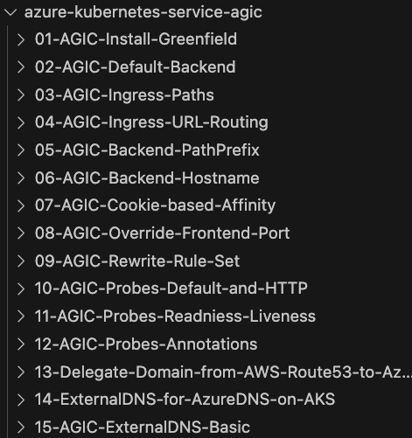
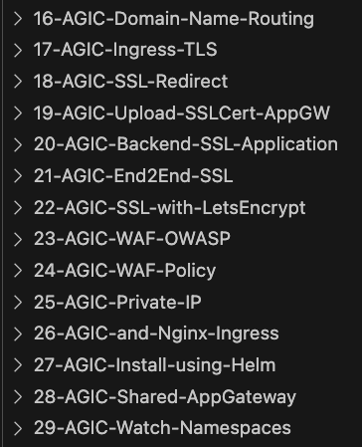
Azure Kubernetes Service + Application Gateway Ingress Controller
Step by Step
Documentation
On
GitHub
for each
Demo

Slide 8

GitHub Repositories
Repository Used For | Repository URL
Course Main Repository with step-by-step documentation | https://github.com/stacksimplify/azure-kubernetes-service-agic
Course Presentation | https://github.com/stacksimplify/azure-kubernetes-service-agic/course-presentation
100+ presentation slides outlining various AGIC Architectural Diagrams we have implemented

Slide 9








Azure Application Gateway Ingress Controller
Azure
Cloud
Virtual Network (10.224.0.0/12)
Subnet: 10.225.0.0/16
Subnet: 10.224.0.0/16
AKS Cluster
1
AGIC monitors the k8s API Server for Ingress Resources
AppGW
Public IP
2
AGIC converts ingress resource to AppGw specific configuration and applies to Azure Resource Manager
3
Azure Resource Manager applies the changes to AppGw (Continuous Reconfiguration of AppGw)
3
Application
Gateway
2
1
Azure Resource
Manager
AGIC Ingress Controller
k8s API Server
Demo-01

Slide 10


Azure AGIC - Ingress Default Backend
Azure
Cloud
Virtual Network (10.224.0.0/12)
Subnet: 10.225.0.0/16
Subnet: 10.224.0.0/16
Users
AKS Cluster
defaultBackend
Ingress Service
AppGW
Public IP
Application
Gateway
MyApp
3
2
1
Azure Resource
Manager
AGIC Ingress Controller
k8s API Server
Demo-02

Slide 11
Azure AGIC - Ingress HTTP Rules & Paths
Azure
Cloud
Virtual Network (10.224.0.0/12)
Users
Subnet: 10.225.0.0/16
Subnet: 10.224.0.0/16
AKS Cluster
HTTP Rules & Paths
Ingress Service
AppGW
Public IP
/app1
Application
Gateway
App1
3
1
2
AGIC Ingress Controller
k8s API Server
Azure Resource
Manager
Demo-03

Slide 12
Azure AGIC - Ingress URL Routing
Azure
Cloud
Virtual Network (10.224.0.0/12)
Users
Subnet: 10.225.0.0/16
Subnet: 10.224.0.0/16
AKS Cluster
App1
AppGW
Public IP
/app1
/app2
App2
Application
Gateway
default or “/”
MyApp
3
2
1
AGIC Ingress Controller
k8s API Server
Azure Resource
Manager
Demo-04

Slide 13
Azure AGIC - Ingress Backend Path Prefix
Azure
Cloud
Virtual Network (10.224.0.0/12)
Users
Subnet: 10.225.0.0/16
Subnet: 10.224.0.0/16
http://<IP>/myapps/app1
AKS Cluster
AppGW
Public IP
/myapps/app1
appgw.ingress.kubernetes.io/backend-path-prefix: "/app1/"
/app1
Serves content using /app1 from Pod
Application
Gateway
App1
3
1
2
AGIC Ingress Controller
k8s API Server
Azure Resource
Manager
Demo-05

Slide 14
Azure AGIC - Ingress Backend Hostname
Azure
Cloud
Virtual Network (10.224.0.0/12)
Users
Subnet: 10.225.0.0/16
Subnet: 10.224.0.0/16
AKS Cluster
appgw.ingress.kubernetes.io/backend-hostname: "internal.stacksimplify.com"
AppGW
Public IP
/
EchoServer
Application
Gateway
3
1
2
AGIC Ingress Controller
k8s API Server
Azure Resource
Manager
Demo-06

Slide 15
Azure AGIC - Ingress Cookie based Affinity
Azure
Cloud
Virtual Network (10.224.0.0/12)
Users
Subnet: 10.225.0.0/16
Subnet: 10.224.0.0/16
AKS Cluster
appgw.ingress.kubernetes.io/cookie-based-affinity: "true"
AppGW
Public IP
/
Requests will be persisted to pod
Application
Gateway
Echo Server
3
1
2
AGIC Ingress Controller
k8s API Server
Azure Resource
Manager
Demo-07-01

Slide 16
Azure AGIC - Ingress Distinct Cookie
Azure
Cloud
Virtual Network (10.224.0.0/12)
Users
Subnet: 10.225.0.0/16
Subnet: 10.224.0.0/16
AKS Cluster
appgw.ingress.kubernetes.io/cookie-based-affinity: "true"
AppGW
Public IP
appgw.ingress.kubernetes.io/cookie-based-affinity-distinct-name: "true"
Requests will be persisted to pod
/
Application
Gateway
Echo Server
3
1
2
AGIC Ingress Controller
k8s API Server
Azure Resource
Manager
Demo-07-02

Slide 17
Azure AGIC - Ingress Override Frontend Port
Azure
Cloud
Virtual Network (10.224.0.0/12)
Users
Subnet: 10.225.0.0/16
Subnet: 10.224.0.0/16
http://PUBLIC-IP:8080
AKS Cluster
appgw.ingress.kubernetes.io/override-frontend-port: "8080"
AppGW
Public IP
/
MyApp
Application
Gateway
3
1
2
AGIC Ingress Controller
k8s API Server
Azure Resource
Manager
Demo-08

Slide 18
Azure AGIC - Ingress Rewrite Rule Set
Azure
Cloud
Virtual Network (10.224.0.0/12)
Users
Subnet: 10.225.0.0/16
Subnet: 10.224.0.0/16
AKS Cluster
appgw.ingress.kubernetes.io/rewrite-rule-set: my-headers-rewrite-ruleset
AppGW
Public IP
/
Rewritten data sent to Pod
Rewrite Set
Header Name: mydomain
Header Value: stacksimplify.com
Application
Gateway
Echo Server
3
1
2
AGIC Ingress Controller
k8s API Server
Azure Resource
Manager
Demo-09

Slide 19
Health Probes
AGIC Health Probe Annotations defined in Ingress Resource
P
R
I
O
R
I
T
Y
O
R
D
E
R
HIGH
Health probes can determine if the configured backend target can serve requests.
Readiness Probe defined in Kubernetes Workloads (Pod, Deployment, StatefulSet)
AppGw won’t send incoming requests to the backend target if a configured health probe fails. Instead, it will respond to the request with an HTTP 502 Error.
Liveness Probe defined in Kubernetes Workloads (Pod, Deployment, StatefulSet)
If the health probe is successful, incoming requests will be forwarded to the backend target
AGIC defined fallback Health Probe
(default HTTP probe,
HTTP Path Probes)
LOW

Slide 20
Azure AGIC - Ingress Health Probes
Azure
Cloud
Virtual Network (10.224.0.0/12)
Users
Subnet: 10.225.0.0/16
Subnet: 10.224.0.0/16
AKS Cluster
Usecase-1
AppGW
Public IP
Default HTTP Probe
Ingress
Default Backend
/
MyApp
Application
Gateway
3
1
2
AGIC Ingress Controller
k8s API Server
Azure Resource
Manager
Demo-10-01

Slide 21
Azure AGIC - Ingress Health Probes
Azure
Cloud
Virtual Network (10.224.0.0/12)
Users
Subnet: 10.225.0.0/16
Subnet: 10.224.0.0/16
AKS Cluster
Usecase-2
AppGW
Public IP
Custom HTTP Probe
Ingress
HTTP Path /app1
/app1
App1
Application
Gateway
3
1
2
AGIC Ingress Controller
k8s API Server
Azure Resource
Manager
Demo-10-02

Slide 22
Azure AGIC Ingress - Readiness Probe
Azure
Cloud
Virtual Network (10.224.0.0/12)
Users
Subnet: 10.225.0.0/16
Subnet: 10.224.0.0/16
AKS Cluster
Usecase-1
AppGW
Public IP
Custom HTTP Probe
Readiness Probe
/
App1
Application
Gateway
3
1
2
AGIC Ingress Controller
k8s API Server
Azure Resource
Manager
Demo-11-01

Slide 23
Azure AGIC Ingress - Liveness Probe
Azure
Cloud
Virtual Network (10.224.0.0/12)
Users
Subnet: 10.225.0.0/16
Subnet: 10.224.0.0/16
AKS Cluster
Usecase-2
AppGW
Public IP
Custom HTTP Probe
Liveness Probe
/
App2
Application
Gateway
3
1
2
AGIC Ingress Controller
k8s API Server
Azure Resource
Manager
Demo-11-02

Slide 24
Azure AGIC Ingress - Readiness & Liveness Probes
Azure
Cloud
Virtual Network (10.224.0.0/12)
Users
Subnet: 10.225.0.0/16
Subnet: 10.224.0.0/16
AKS Cluster
When both probes are present which, one takes priority ?
Usecase-3
Readiness Probe
AppGW
Public IP
Custom HTTP Probe
Liveness Probe
/
App1
Application
Gateway
3
1
2
AGIC Ingress Controller
k8s API Server
Azure Resource
Manager
Demo-11-03

Slide 25
Azure AGIC Ingress - Health Probe Annotations
Azure
Cloud
Virtual Network (10.224.0.0/12)
Users
Subnet: 10.225.0.0/16
Subnet: 10.224.0.0/16
AKS Cluster
Azure AGIC Health Probe Annotations
AppGW
Public IP
Custom HTTP Probe
/
App1
Application
Gateway
3
1
2
AGIC Ingress Controller
k8s API Server
Azure Resource
Manager
Demo-12

Slide 26



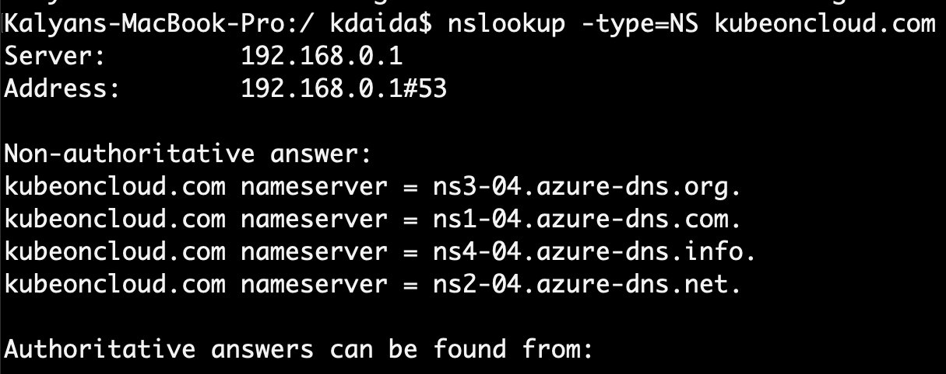
Delegate Domain to Azure DNS
AWS Cloud
Azure Cloud
DNZ Zones
Domain Registrar
kubeoncloud.com
kubeoncloud.com
AWS Route53
Azure DNS Zones
Demo-13

Slide 27



Azure AGIC Ingress - External DNS Install
Azure Cloud
Virtual Network (10.224.0.0/12)
Subnet: 10.225.0.0/16
Subnet: 10.224.0.0/16
Users
AKS Cluster
External DNS allows us to add / update / delete DNS Records in Azure DNS Zones declaratively from Ingress Service
AppGW Public IP
Application
Gateway
Azure Config File (azure.json)
DNS
Zones
External DNS
Managed
Service
Identity
AKS NodePool VMSS
AGIC Ingress Controller
k8s API Server
Azure Resource
Manager
Demo-14

Slide 28
Azure AGIC Ingress - External DNS Basic
Azure Cloud
Virtual Network (10.224.0.0/12)
myapp1.kubeoncloud.com
Subnet: 10.225.0.0/16
Subnet: 10.224.0.0/16
Users
AKS Cluster
myapp1.kubeoncloud.com
AppGW Public IP
Application
Gateway
App1
DNS
Zones
HOST
(spec.rules.host)
Ingress Service
Managed
Service
Identity
AKS NodePool VMSS
External DNS
AGIC Ingress Controller
k8s API Server
Azure Resource
Manager
Demo-15

Slide 29
Azure AGIC - Ingress Domain Name Routing
Azure Cloud
Virtual Network (10.224.0.0/12)
eapp1.kubeoncloud.com
eapp2.kubeoncloud.com
Subnet: 10.225.0.0/16
Subnet: 10.224.0.0/16
eapp3.kubeoncloud.com
Users
AKS Cluster
eapp1.kubeoncloud.com
eapp2.kubeoncloud.com
App1
AppGW Public IP
Application
Gateway
eapp3.kubeoncloud.com
DNS
Zones
App2
Managed
Service
Identity
AKS NodePool VMSS
External DNS
App3
AGIC Ingress Controller
k8s API Server
Azure Resource
Manager
Demo-16

Slide 30
Azure AGIC - Ingress SSL TLS
Azure Cloud
Virtual Network (10.224.0.0/12)
https://app1.kubeoncloud.com
Subnet: 10.225.0.0/16
Subnet: 10.224.0.0/16
Users
AKS Cluster
App1
app1.kubeoncloud.com
AppGW Public IP
Application
Gateway
TLS Certificate
DNS
Zones
SSL Cert
SSL Key
K8s Secret
Managed
Service
Identity
TLS
(spec.tls.secretName)
External DNS
Ingress Service
AKS NodePool VMSS
AGIC Ingress Controller
k8s API Server
Azure Resource
Manager
Demo-17

Slide 31
Azure AGIC - Ingress SSL TLS Redirect
Azure Cloud
Virtual Network (10.224.0.0/12)
appgw.ingress.kubernetes.io/ssl-redirect: "true"
http://app1.kubeoncloud.com
HTTP -> HTTPS
Subnet: 10.225.0.0/16
Subnet: 10.224.0.0/16
Users
AKS Cluster
App1
app1.kubeoncloud.com
AppGW Public IP
Application
Gateway
TLS Certificate
DNS
Zones
SSL Cert
SSL Key
K8s Secret
Managed
Service
Identity
TLS
(spec.tls.secretName)
External DNS
Ingress Service
AKS NodePool VMSS
AGIC Ingress Controller
k8s API Server
Azure Resource
Manager
Demo-18

Slide 32
Azure AGIC - Ingress SSL + SSL Upload to AppGw
Azure Cloud
Virtual Network (10.224.0.0/12)
https://app2.kubeoncloud.com
HTTP -> HTTPS
Subnet: 10.225.0.0/16
Subnet: 10.224.0.0/16
Users
AKS Cluster
App2
app2.kubeoncloud.com
AppGW Public IP
Application
Gateway
TLS Certificate
appgw.ingress.kubernetes.io/appgw-ssl-certificate: "app2sslcert"
DNS
Zones
SSL Manual Upload to AppGw
appgw.ingress.kubernetes.io/ssl-redirect: "true"
SSL PFX
SSL Cert
Managed
Service
Identity
SSL Key
AKS NodePool VMSS
External DNS
AGIC Ingress Controller
k8s API Server
Azure Resource
Manager
Demo-19

Slide 33


Azure AGIC Ingress E2E SSL - Build Backend SSL App
Azure Cloud
Virtual Network (10.224.0.0/12)
https://PUBLIC-IP
Subnet: 10.225.0.0/16
Subnet: 10.224.0.0/16
Users
AKS Cluster
HTTPS
LB Public IP
HTTPS
Backend SSL
SSL Cert
SSL Key
Backend
K8s Secret
MyApp
Azure
Load Balancer
Demo-20

Slide 34
Azure AGIC - Ingress E2E SSL
Azure Cloud
Virtual Network (10.224.0.0/12)
https://frontend.kubeoncloud.com
HTTP -> HTTPS
Subnet: 10.225.0.0/16
Subnet: 10.224.0.0/16
Users
AKS Cluster
frontend.kubeoncloud.com
AppGW Public IP
Application
Gateway
Frontend Cert and Key
HTTPS
Backend Cert or Root Cert
Backend SSL
Frontend SSL
DNS
Zones
SSL Cert
SSL Cert
SSL Key
Backend
K8s Secret
Frontend
K8s Secret
SSL Key
MyApp
Managed
Service
Identity
AKS NodePool VMSS
External DNS
AGIC Ingress Controller
k8s API Server
Azure Resource
Manager
Demo-21

Slide 35
Azure AGIC - Ingress SSL with Let's Encrypt
Azure Cloud
https://sapp1.kubeoncloud.com
Virtual Network (10.224.0.0/12)
cert-manager.io/cluster-issuer: letsencrypt
https://sapp2.kubeoncloud.com
Subnet: 10.225.0.0/16
Subnet: 10.224.0.0/16
Users
AKS
Cluster
HTTP -> HTTPS
sapp1.kubeoncloud.com
SSL Cert
sapp2.kubeoncloud.com
SSL Key
sapp1 SSL cert
App1
sapp1
AppGW Public IP
Application
Gateway
Auto-Generated
L
E
T
S
ENCR
y
P
T
sapp2 SSL cert
DNS
Zones
SSL Cert
SSL Key
App2
sapp2
Managed
Service
Identity
AKS NodePool VMSS
External DNS
Cert-Manager
AGIC Ingress Controller
k8s API Server
Azure Resource
Manager
Demo-22

Slide 36

Azure AGIC - Ingress + Enable WAF on AppGw
Azure Cloud
Virtual Network (10.224.0.0/12)
http://myapp1.kubeoncloud.com
Subnet: 10.225.0.0/16
Subnet: 10.224.0.0/16
Users
Application Gateway
AKS Cluster
MyApp
myapp1.kubeoncloud.com
AppGW Public IP
Default
OWASP
Policies
WAF
AGIC Ingress Controller
k8s API Server
Azure Resource
Manager
Demo-23

Slide 37
Azure AGIC - Ingress + WAF Custom Policy
Azure Cloud
Virtual Network (10.224.0.0/12)
http://myapp1.kubeoncloud.com
Subnet: 10.225.0.0/16
Subnet: 10.224.0.0/16
Users
Application Gateway
AKS Cluster
MyApp
myapp1.kubeoncloud.com
AppGW Public IP
Default
OWASP
Policies
appgw.ingress.kubernetes.io/waf-policy-for-path: WAF-RESOURCE-ID
WAF
WAF Custom Policy
AGIC Ingress Controller
k8s API Server
Azure Resource
Manager
Demo-24

Slide 38

Azure AGIC - Ingress Private IP
Azure Cloud
Virtual Network (10.224.0.0/12)
Subnet: 10.225.0.0/16
Subnet: 10.224.0.0/16
AKS Cluster
Test User
curl http://private-ip
curl pod
Application Gateway
appgw.ingress.kubernetes.io/use-private-ip: "true"
Private IP
/
AppGW Public IP
Echo Server
AGIC Ingress Controller
k8s API Server
Azure Resource
Manager
Demo-25

Slide 39
Azure AGIC - Multiple Ingress Controllers
Azure Cloud
Virtual Network (10.224.0.0/12)
Subnet: 10.225.0.0/16
Subnet: 10.224.0.0/16
AKS Cluster
Azure Load Balancer
LB Public IP
NGINX Ingress Controller
App1
Application Gateway
Users
/
App2
AppGW Public IP
AGIC Ingress Controller
k8s API Server
Azure Resource
Manager
Demo-26

Slide 40
Azure Application Gateway Ingress Controller install using Helm
Azure
Cloud
Virtual Network (10.224.0.0/12)
Subnet: 10.225.0.0/16
Subnet: 10.224.0.0/16
AKS Cluster
AppGW
Public IP
3
Application
Gateway
2
1
Azure Resource
Manager
AGIC Ingress Controller
k8s API Server
Demo-27

Slide 41

Azure AGIC - Shared Application Gateway
Azure Cloud
Virtual Network (10.224.0.0/12)
shared: true
Subnet: 10.225.0.0/16
AzureIngressProhibitedTargets CRD
myaciapp1
myaciapp1.kubeoncloud.com
myaciapp2.kubeoncloud.com
Users
myaciapp2
AppGW Public IP
/
Subnet: 10.224.0.0/16
Application
Gateway
AKS Cluster
App1
AGIC Ingress Controller
k8s API Server
Azure Resource
Manager
Demo-28

Slide 42
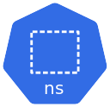
Azure AGIC - Watch Namespaces
Azure
Cloud
Virtual Network (10.224.0.0/12)
Watch All Namespaces
Users
Subnet: 10.225.0.0/16
Subnet: 10.224.0.0/16
AKS Cluster
Namespace: Staging
AppGW
Public IP
App1
/app1
Namespace: Production
/app2
Application
Gateway
App2
3
2
1
AGIC Ingress Controller
k8s API Server
Azure Resource
Manager
Demo-29-01

Slide 43
Azure AGIC - Watch Namespaces
Azure
Cloud
Virtual Network (10.224.0.0/12)
Watch Prod Namespace
Users
Subnet: 10.225.0.0/16
Subnet: 10.224.0.0/16
AKS Cluster
Namespace: Staging
AppGW
Public IP
App1
Namespace: Production
/app2
Application
Gateway
App2
3
2
1
AGIC Ingress Controller
k8s API Server
Azure Resource
Manager
Demo-29-02

Slide 44
Azure AKS
AGIC
Greenfield Deployment
AGIC AKS Add On
Demo-01

Slide 45
What is AGIC ?
Azure Application Gateway Ingress Controller
Azure Cloud
Application
Gateway
Azure AGIC is a Kubernetes Application deployed on Azure AKS Cluster
AKS Cluster
With AGIC we can expose k8s applications deployed on AKS Cluster using Azure Application Gateway L7 Load Balancer
AGIC Ingress Controller

Slide 46
Azure Application Gateway Ingress Controller
Azure
Cloud
Virtual Network (10.224.0.0/12)
Subnet: 10.225.0.0/16
Subnet: 10.224.0.0/16
AKS Cluster
1
AGIC monitors the k8s API Server for Ingress Resources
AppGW
Public IP
2
AGIC converts ingress resource to AppGw specific configuration and applies to Azure Resource Manager
3
Azure Resource Manager applies the changes to AppGw (Continuous Reconfiguration of AppGw)
3
Application
Gateway
2
1
Azure Resource
Manager
AGIC Ingress Controller
k8s API Server

Slide 47
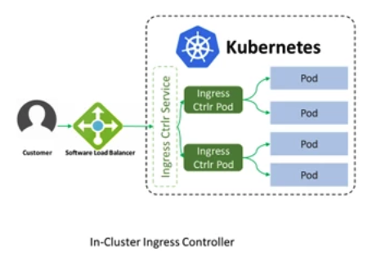
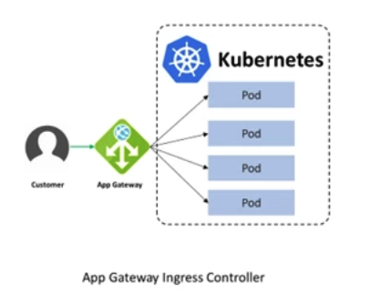
Azure AGIC vs Other In-Cluster Ingress Controllers
NGINXIC
Image Reference: Microsoft Blog
AGIC
Image Reference: Microsoft Blog
Traffic flows via Ingress Controller k8s Service and Pods (Additional Network Hops)
Traffic flows from Application Gateway directly to k8s Pods
Uses AKS cluster compute resources for traffic flow
AKS Compute resources are not used for traffic flow
AGIC uses AKS compute resources just to transform Ingress Service manifest to AppGW config and submit to Azure Resource Manager (Only during Ingress resource create/update/delete actions)
Additional Reference: https://azure.microsoft.com/en-us/blog/application-gateway-ingress-controller-for-azure-kubernetes-service/

Slide 48
Azure AGIC Deployment Options
Azure AGIC
Deployment
Azure
Recommended
As AKS Add-On
Using Helm
Greenfield
Brownfield
Greenfield
Brownfield
New
AKS Cluster
Existing
AKS Cluster
New
AKS Cluster
Existing
AKS Cluster
New Application GW
Existing Application GW
New Application GW
Existing Application GW
With AKS AGIC AddOn Deployment is super simple
Supports additional features (verbose levels, auth type)
Fully managed service provided by Microsoft
Shared: Same AppGW can be shared with other Azure Services
Automatic Updates and increased support
ProhibitedTargets: Configure AppGw without affecting other backends
First-class Add On
Manually upgrade AGIC using HELM (No Automatic), Use latest or desired versions

Slide 49
Azure Application Gateway Ingress Controller
Azure
Cloud
Virtual Network (10.224.0.0/12)
Subnet: 10.225.0.0/16
Subnet: 10.224.0.0/16
AKS Cluster
AppGW
Public IP
AGIC Managed
Identity
Application
Gateway
Azure Resource
Manager
AGIC Ingress Controller
k8s API Server

Slide 50
Demo-02
Azure AKS
AGIC
Ingress Default Backend

Slide 51
Azure AGIC - Ingress Default Backend
Azure
Cloud
Virtual Network (10.224.0.0/12)
Subnet: 10.225.0.0/16
Subnet: 10.224.0.0/16
Users
AKS Cluster
defaultBackend
Ingress Service
AppGW
Public IP
Application
Gateway
MyApp
3
2
1
Azure Resource
Manager
AGIC Ingress Controller
k8s API Server

Slide 52
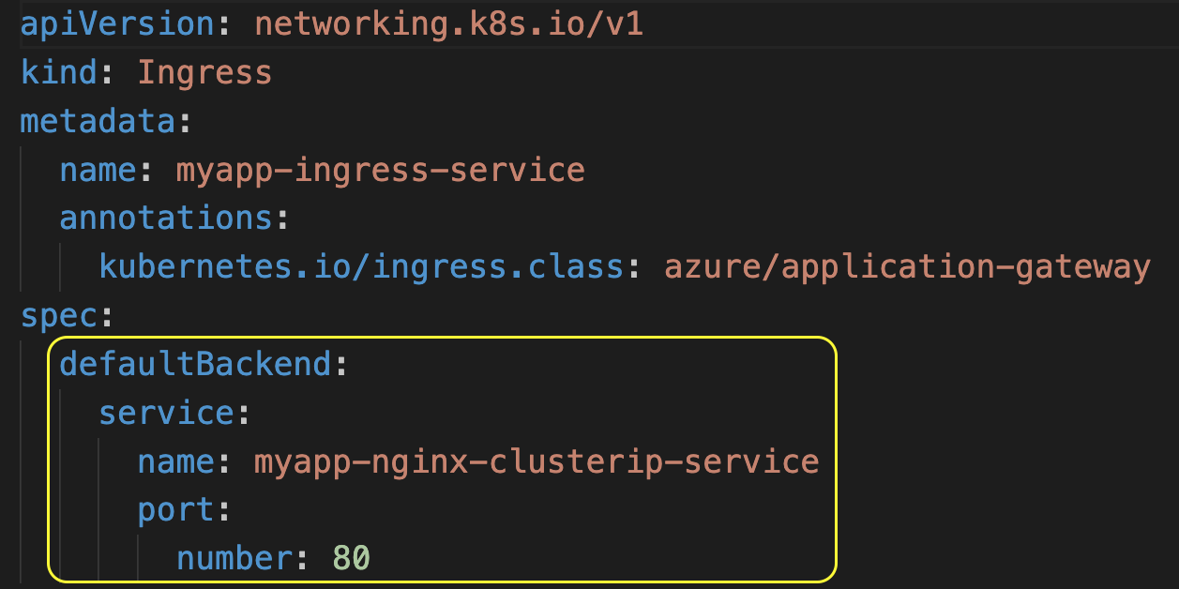
Azure AGIC - Ingress Default Backend
Ingress
Default Backend

Slide 53
Demo-03
Azure AKS
AGIC
Ingress HTTP Rules & Paths

Slide 54
Azure AGIC - Ingress HTTP Rules & Paths
Azure
Cloud
Virtual Network (10.224.0.0/12)
Users
Subnet: 10.225.0.0/16
Subnet: 10.224.0.0/16
AKS Cluster
HTTP Rules & Paths
Ingress Service
AppGW
Public IP
/app1
Application
Gateway
App1
3
1
2
AGIC Ingress Controller
k8s API Server
Azure Resource
Manager

Slide 55
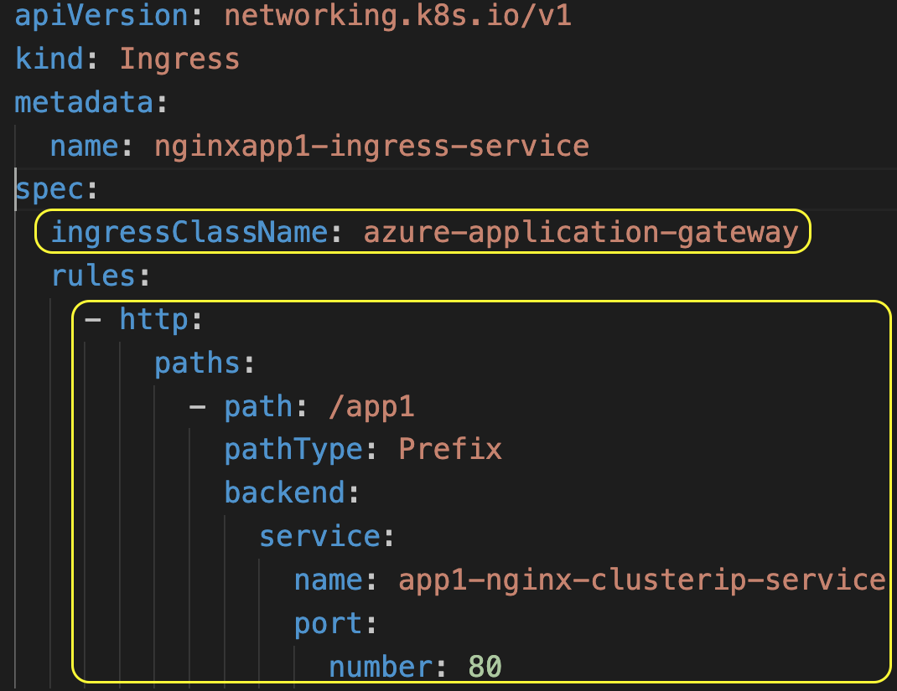
Azure AGIC - Ingress HTTP Rules & Paths
Ingress
Class
Name
Ingress
HTTP
Rules & Paths

Slide 56
Demo-04
Azure AKS
AGIC
Ingress URL Routing

Slide 57
Azure AGIC - Ingress URL Routing
Azure
Cloud
Virtual Network (10.224.0.0/12)
Users
Subnet: 10.225.0.0/16
Subnet: 10.224.0.0/16
AKS Cluster
App1
AppGW
Public IP
/app1
/app2
App2
Application
Gateway
default or “/”
MyApp
3
2
1
AGIC Ingress Controller
k8s API Server
Azure Resource
Manager

Slide 58
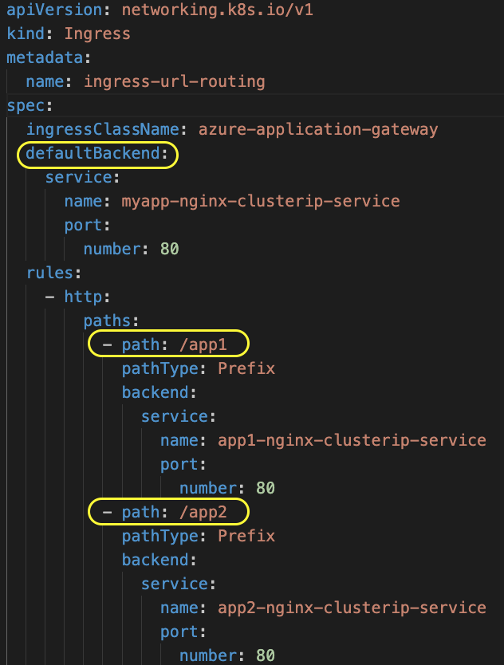
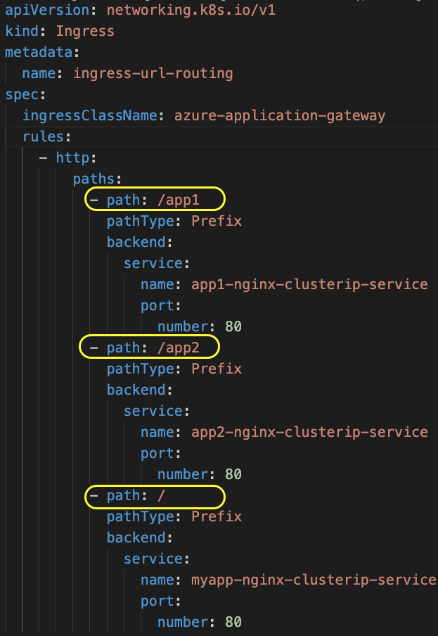
Azure AGIC - Ingress URL Routing
For Root Context we can use Default Backend or
HTTP Paths
With Default Backend
With HTTP Paths

Slide 59
Demo-05
Azure AKS
AGIC
Annotations
Backend Path Prefix

Slide 60
Azure AGIC - Ingress Backend Path Prefix
Azure
Cloud
Virtual Network (10.224.0.0/12)
Users
Subnet: 10.225.0.0/16
Subnet: 10.224.0.0/16
http://<IP>/myapps/app1
AKS Cluster
AppGW
Public IP
/myapps/app1
appgw.ingress.kubernetes.io/backend-path-prefix: "/app1/"
/app1
Serves content using /app1 from Pod
Application
Gateway
App1
3
1
2
AGIC Ingress Controller
k8s API Server
Azure Resource
Manager

Slide 61
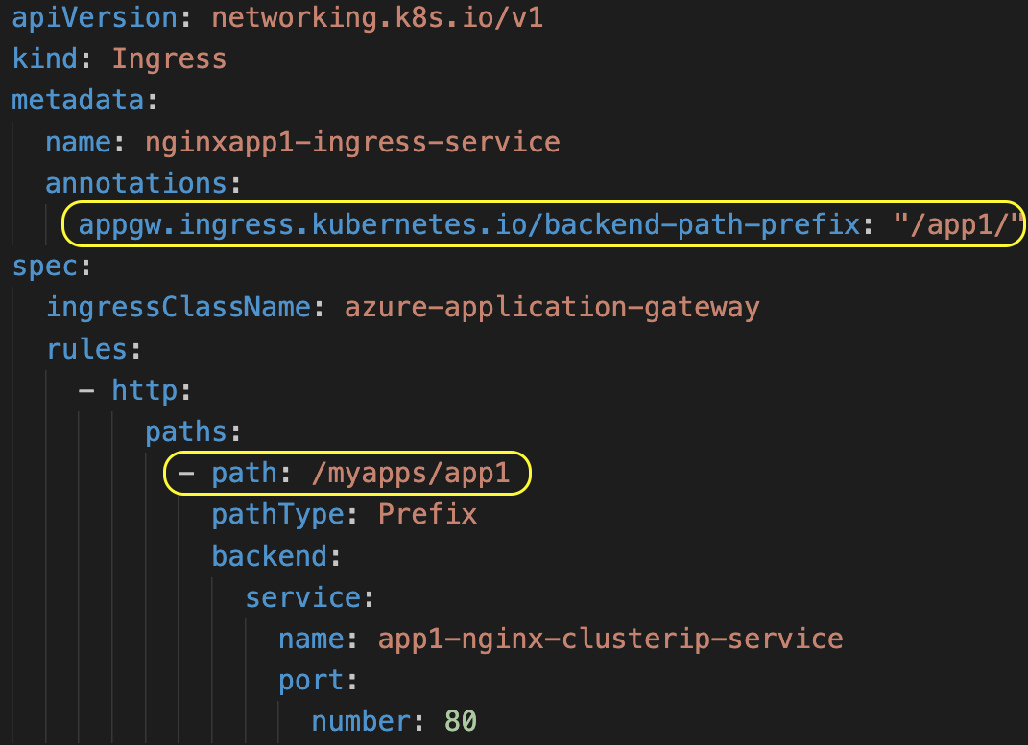
Azure AGIC - Ingress Backend Path Prefix
Backend Path Prefix Annotation
HTTP Path from browser
/myapps/app1
Data serves from k8s Pod
at context
/app1

Slide 62
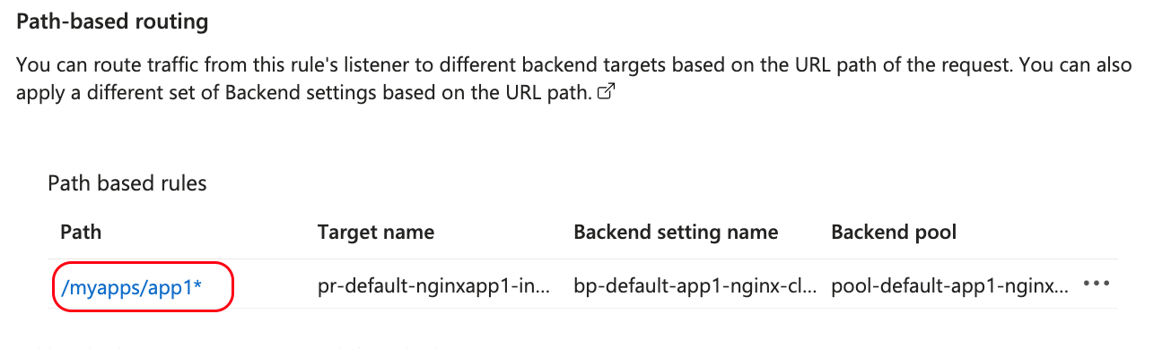
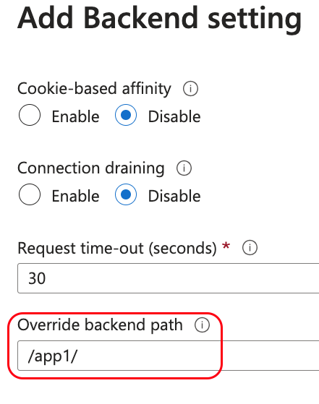
Azure AGIC - Ingress Backend Path Prefix
Application Gateway Rules
Application Backend Settings

Slide 63
Demo-06
Azure AKS
AGIC
Annotations
Backend Hostname

Slide 64
Azure AGIC - Ingress Backend Hostname
Azure
Cloud
Virtual Network (10.224.0.0/12)
Users
Subnet: 10.225.0.0/16
Subnet: 10.224.0.0/16
AKS Cluster
appgw.ingress.kubernetes.io/backend-hostname: "internal.stacksimplify.com"
AppGW
Public IP
/
EchoServer
Application
Gateway
3
1
2
AGIC Ingress Controller
k8s API Server
Azure Resource
Manager

Slide 65
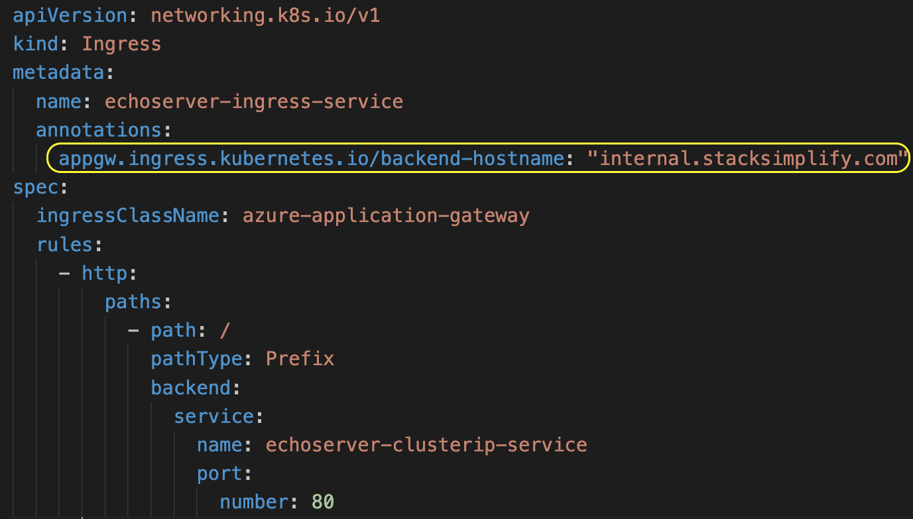
Azure AGIC - Ingress Backend Hostname
Backend
Hostname
Annotation

Slide 66
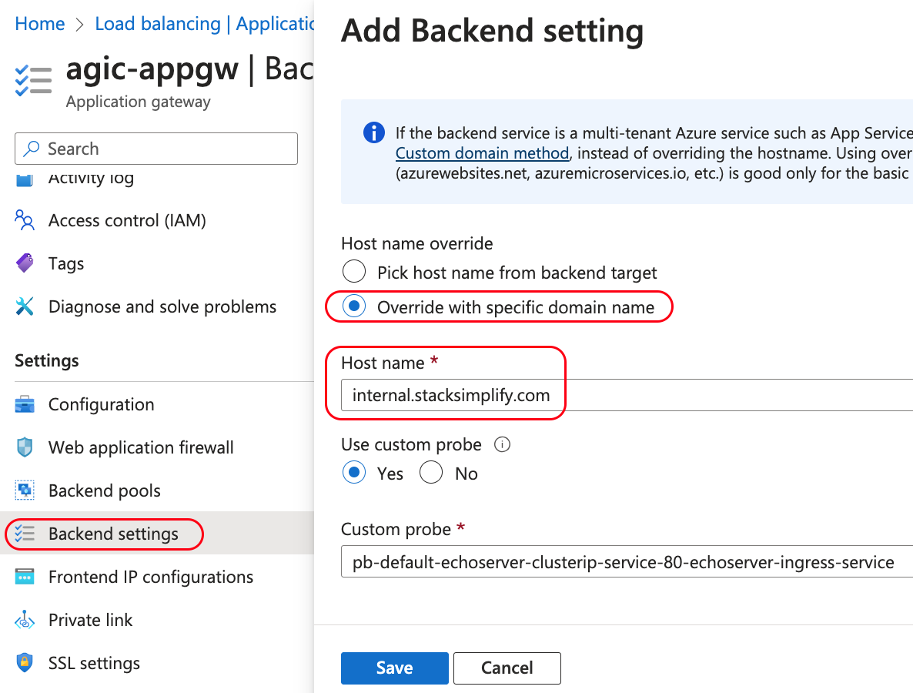
Azure AGIC - Ingress Backend Hostname
Host name override
And
Host name
Backend Settings will be updated

Slide 67
Demo-07
Azure AKS
AGIC
Annotations
Cookie based Affinity

Slide 68
Azure AGIC - Ingress Cookie based Affinity
Azure
Cloud
Virtual Network (10.224.0.0/12)
Users
Subnet: 10.225.0.0/16
Subnet: 10.224.0.0/16
AKS Cluster
appgw.ingress.kubernetes.io/cookie-based-affinity: "true"
AppGW
Public IP
/
Requests will be persisted to pod
Application
Gateway
Echo Server
3
1
2
AGIC Ingress Controller
k8s API Server
Azure Resource
Manager

Slide 69
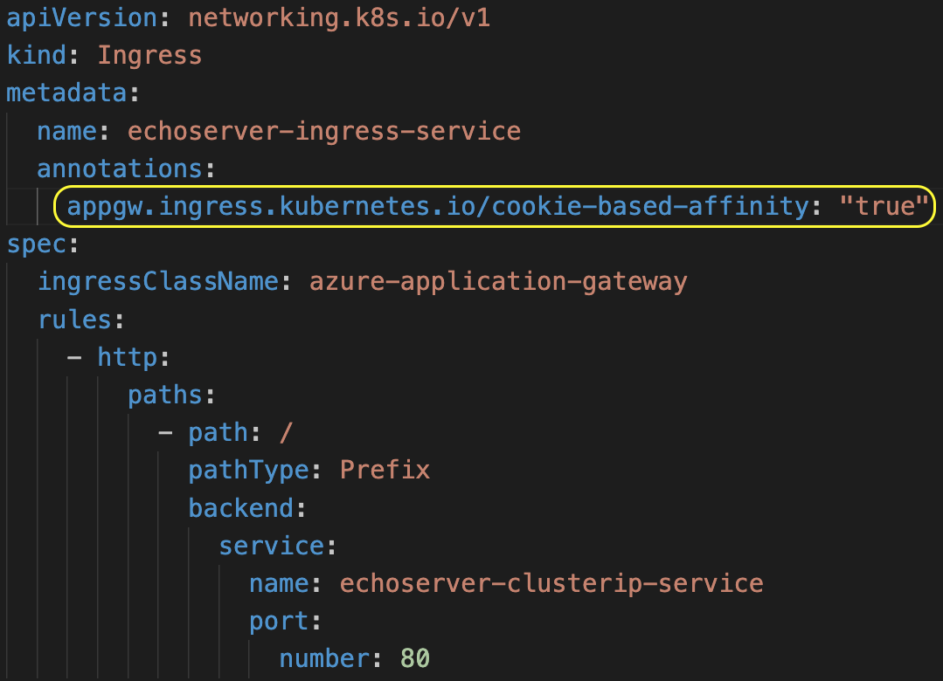
Azure AGIC - Ingress Cookie based Affinity
Cookie
Based
Affinity
Annotation

Slide 70
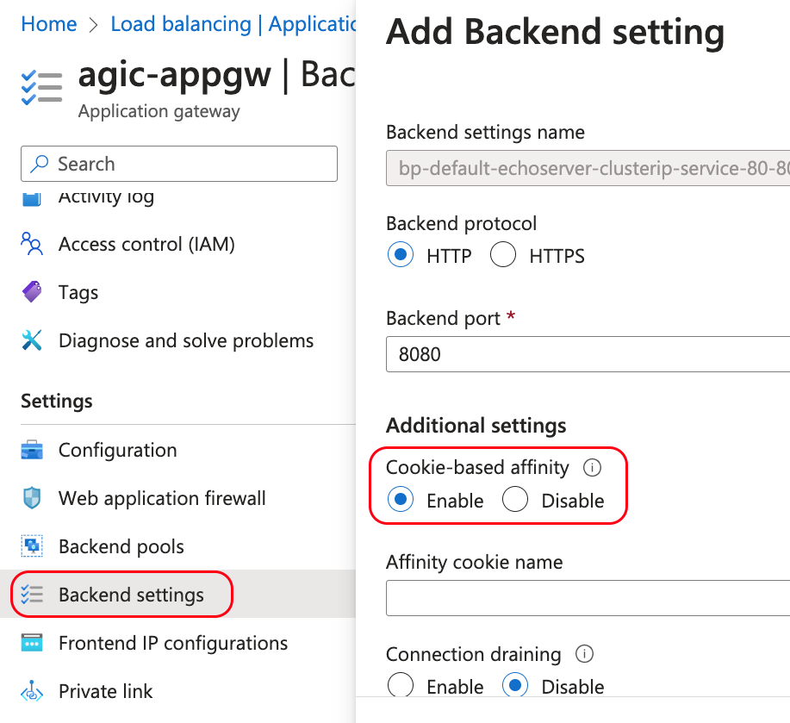
Azure AGIC - Ingress Cookie based Affinity
Cookie-based Affinity Backend Setting will be enabled

Slide 71
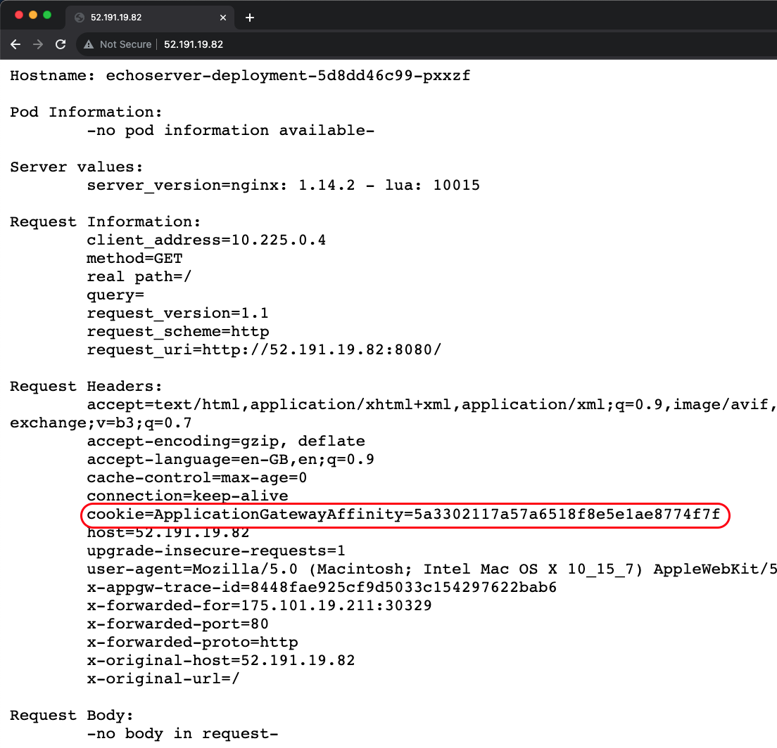
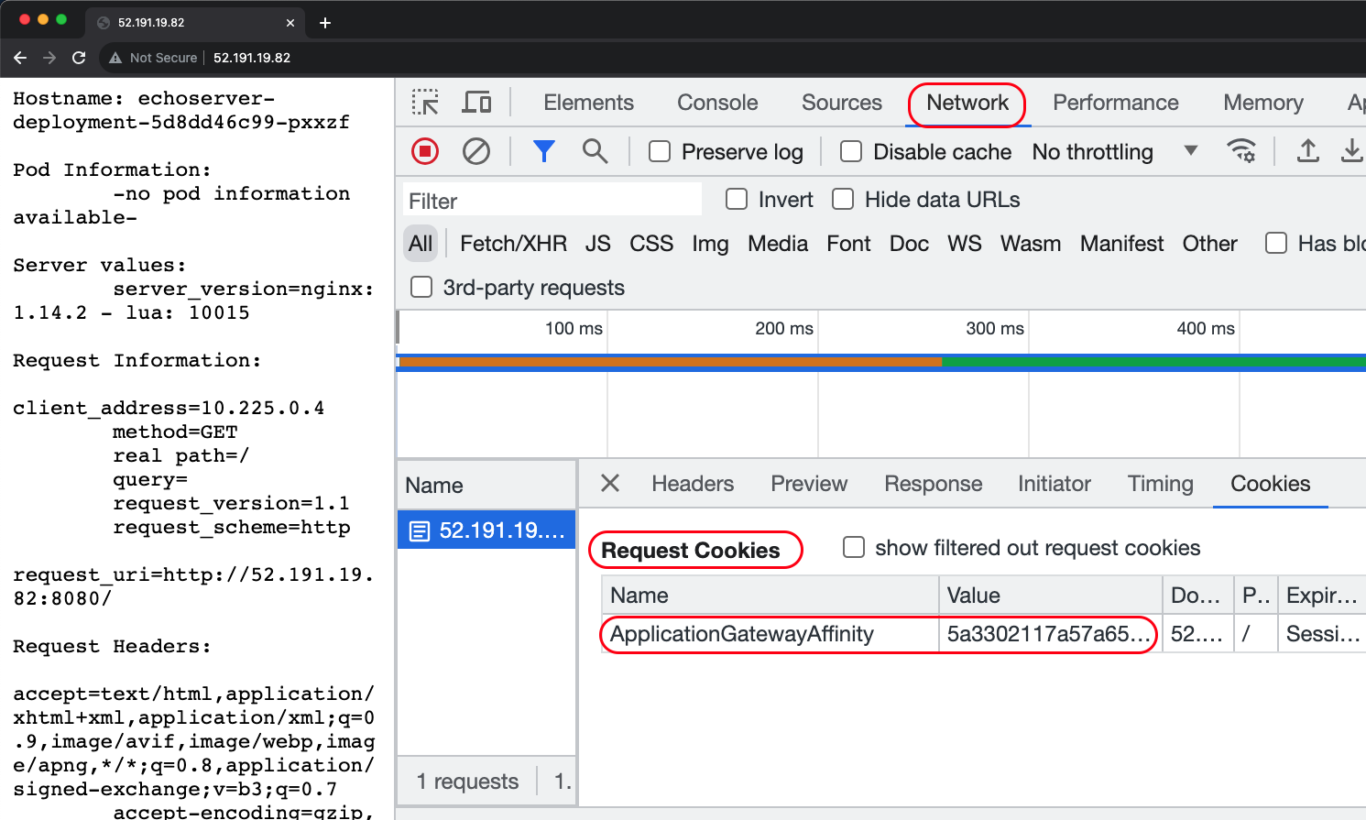
Azure AGIC - Ingress Cookie based Affinity
Echo Server Application Output
Developer Tools Output

Slide 72
Azure AGIC - Ingress Distinct Cookie
Azure
Cloud
Virtual Network (10.224.0.0/12)
Users
Subnet: 10.225.0.0/16
Subnet: 10.224.0.0/16
AKS Cluster
appgw.ingress.kubernetes.io/cookie-based-affinity: "true"
AppGW
Public IP
appgw.ingress.kubernetes.io/cookie-based-affinity-distinct-name: "true"
Requests will be persisted to pod
/
Application
Gateway
Echo Server
3
1
2
AGIC Ingress Controller
k8s API Server
Azure Resource
Manager

Slide 73
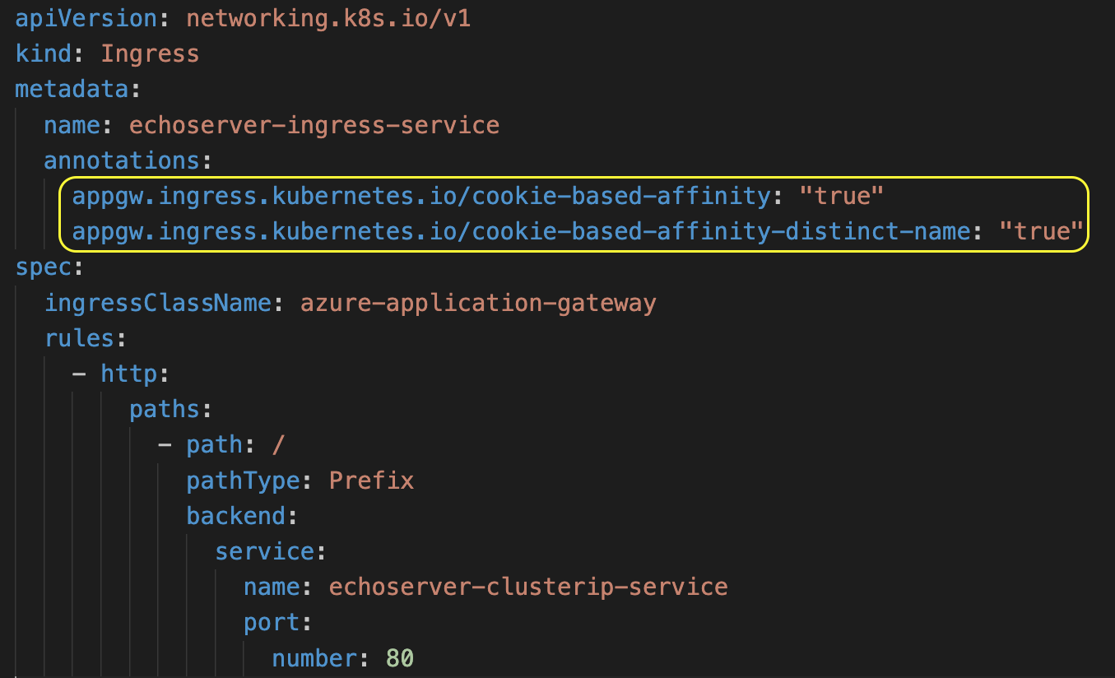
Azure AGIC - Ingress Distinct Cookie
Distinct
Cookie
Annotation

Slide 74
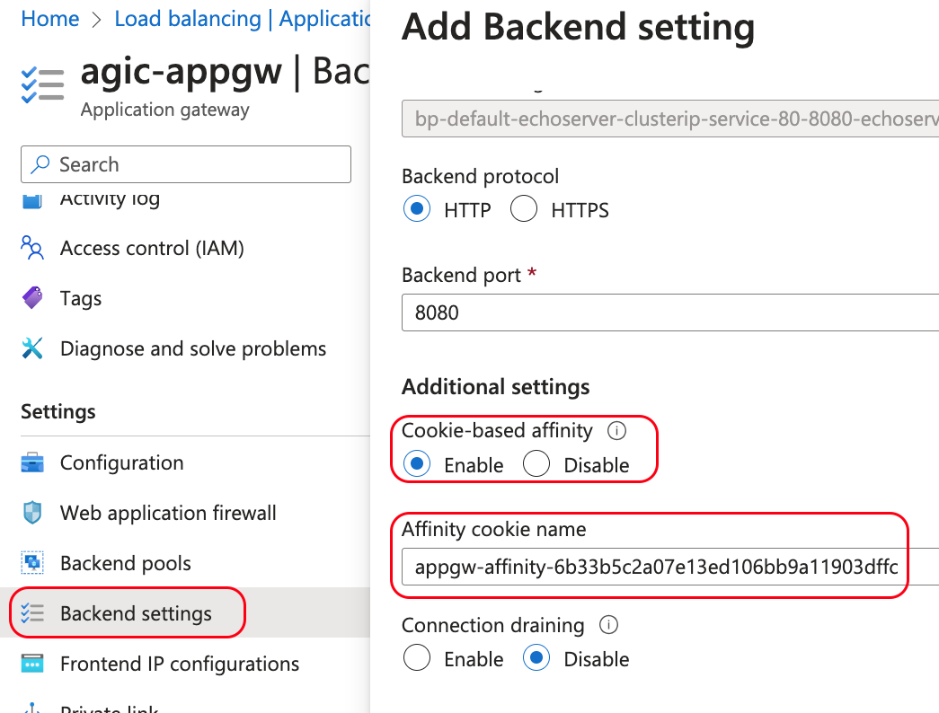
Azure AGIC - Ingress Distinct Cookie
Cookie-based Affinity
and
Affinity cookie name Backend Settings will be enabled

Slide 75
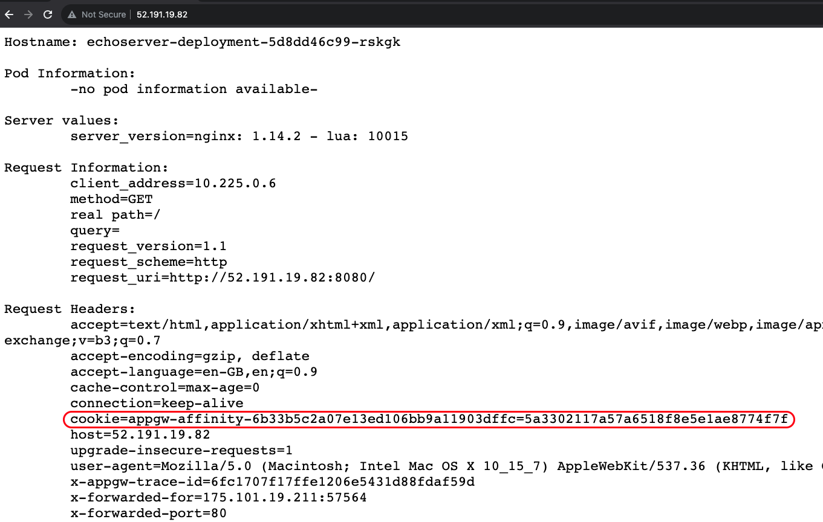
Azure AGIC - Ingress Distinct Cookie
Echo Server
Application
Output

Slide 76
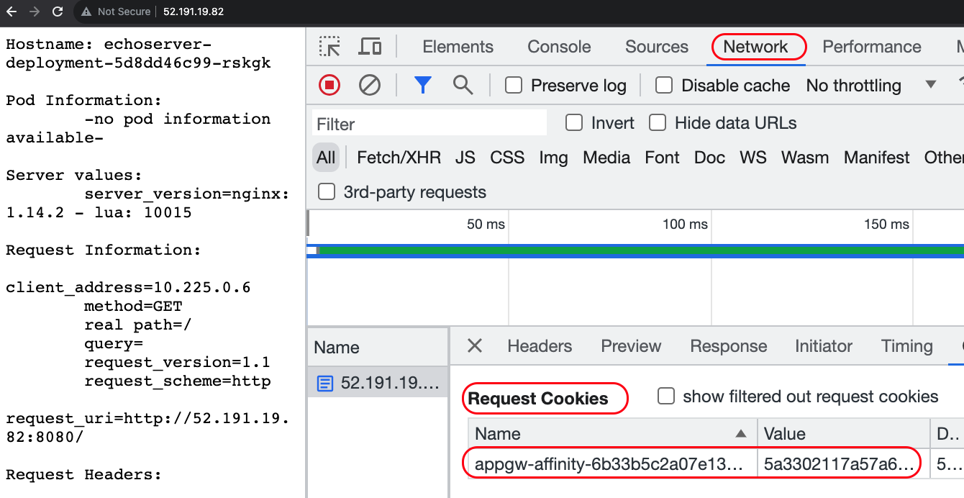
Azure AGIC - Ingress Distinct Cookie
Browser
Developer Tools
Output

Slide 77
Demo-08
Azure AKS
AGIC
Annotations
Override Frontend Port

Slide 78
Azure AGIC - Ingress Override Frontend Port
Azure
Cloud
Virtual Network (10.224.0.0/12)
Users
Subnet: 10.225.0.0/16
Subnet: 10.224.0.0/16
http://PUBLIC-IP:8080
AKS Cluster
appgw.ingress.kubernetes.io/override-frontend-port: "8080"
AppGW
Public IP
/
MyApp
Application
Gateway
3
1
2
AGIC Ingress Controller
k8s API Server
Azure Resource
Manager

Slide 79
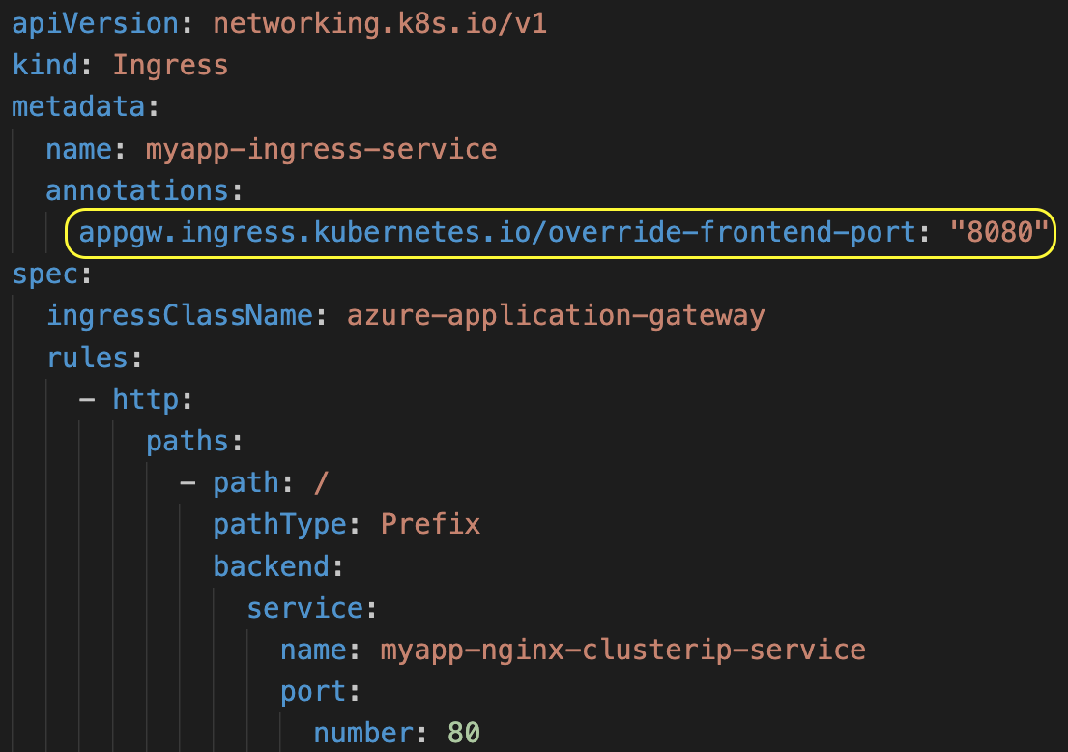
Azure AGIC - Ingress Override Frontend Port
Override
Frontend Port
Annotation

Slide 80
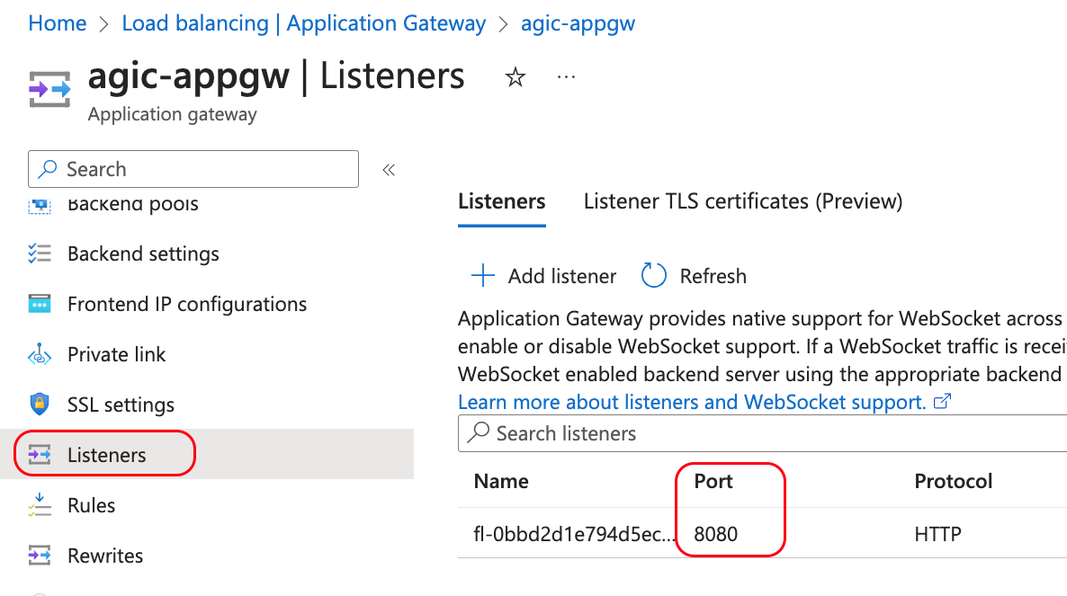
Azure AGIC - Ingress Override Frontend Port
Port 8080
will be updated in
Listeners Settings

Slide 81
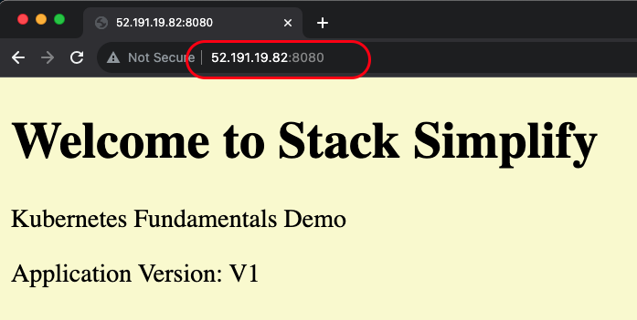
Azure AGIC - Ingress Override Frontend Port
Access in browser with
http://PUBLIC-IP:8080

Slide 82
Demo-09
Azure AKS
AGIC
Annotations
Rewrite Rule Set

Slide 83
Azure AGIC - Ingress Rewrite Rule Set
Azure
Cloud
Virtual Network (10.224.0.0/12)
Users
Subnet: 10.225.0.0/16
Subnet: 10.224.0.0/16
AKS Cluster
appgw.ingress.kubernetes.io/rewrite-rule-set: my-headers-rewrite-ruleset
AppGW
Public IP
/
Rewritten data sent to Pod
Rewrite Set
Header Name: mydomain
Header Value: stacksimplify.com
Application
Gateway
Echo Server
3
1
2
AGIC Ingress Controller
k8s API Server
Azure Resource
Manager

Slide 84
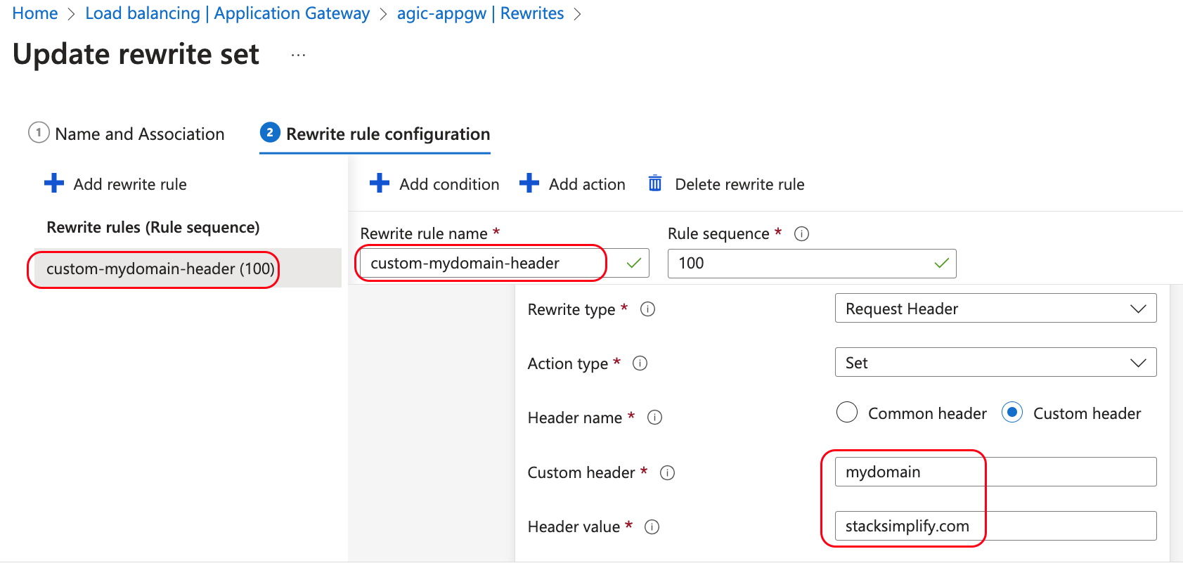
Azure AGIC - Ingress Rewrite Rule Set

Slide 85
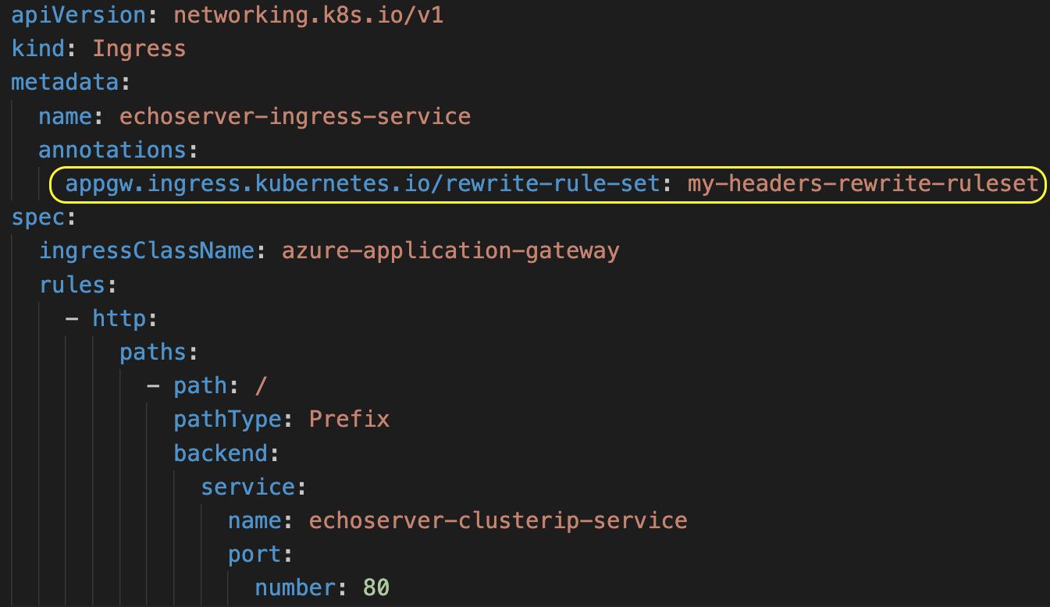
Azure AGIC - Ingress Rewrite Rule Set
Rewrite
Rule Set
Annotation

Slide 86
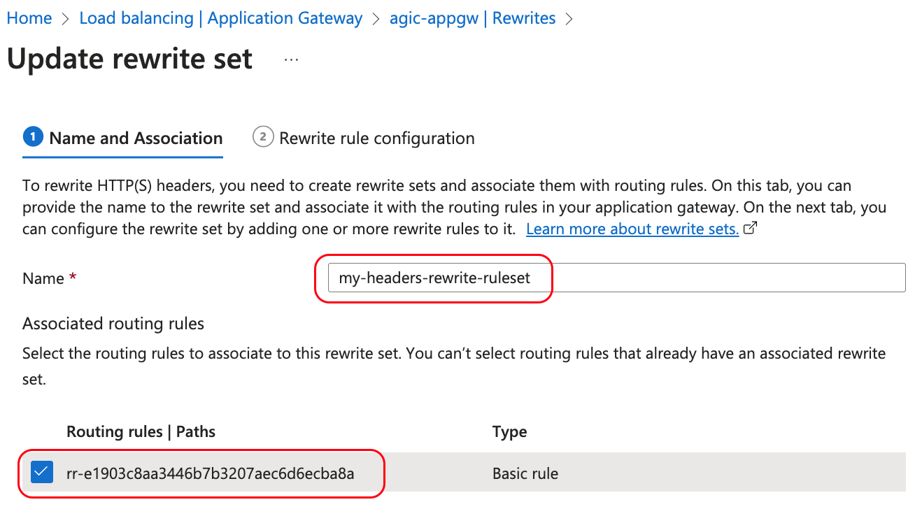
Azure AGIC - Ingress Rewrite Rule Set
Routing Rule
will be selected when Ingress service with rewrite-rule-set Annotation deployed

Slide 87
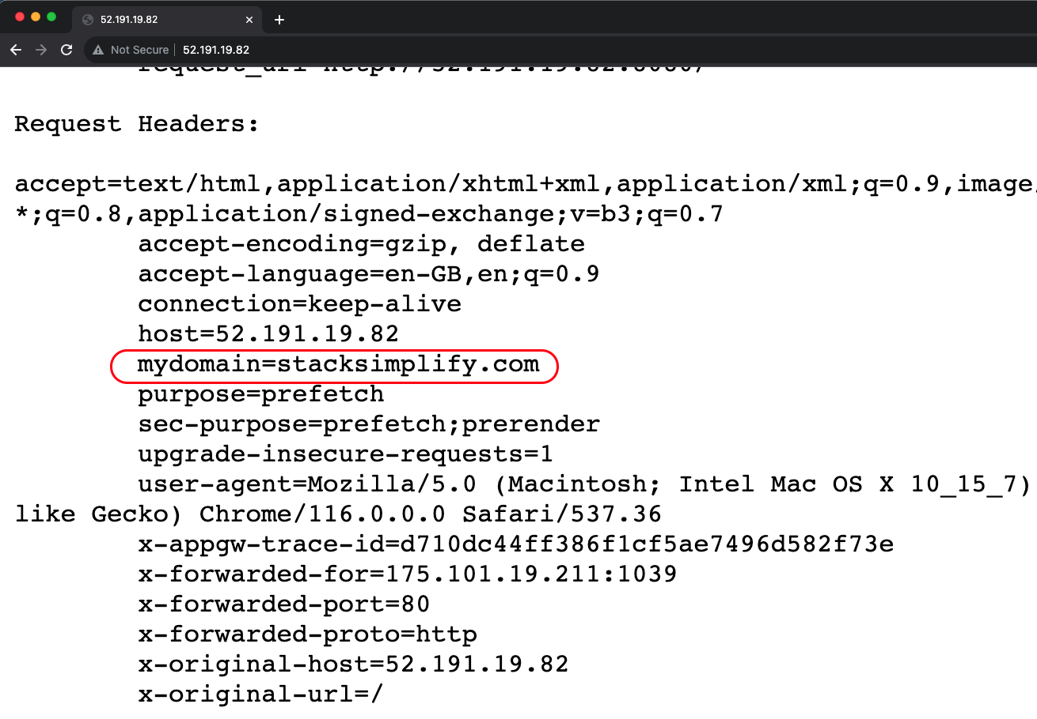
Azure AGIC - Ingress Rewrite Rule Set
Echo Server
Application
Output

Slide 88
Demo-10
Azure AKS
AGIC
Annotations
Health Probes - Default and HTTP

Slide 89
Health Probes
AGIC Health Probe Annotations defined in Ingress Resource
P
R
I
O
R
I
T
Y
O
R
D
E
R
HIGH
Health probes can determine if the configured backend target can serve requests.
Readiness Probe defined in Kubernetes Workloads (Pod, Deployment, StatefulSet)
AppGw won’t send incoming requests to the backend target if a configured health probe fails. Instead, it will respond to the request with an HTTP 502 Error.
Liveness Probe defined in Kubernetes Workloads (Pod, Deployment, StatefulSet)
If the health probe is successful, incoming requests will be forwarded to the backend target
AGIC defined fallback Health Probe
(default HTTP probe,
HTTP Path Probes)
LOW

Slide 90
Azure AGIC - Ingress Health Probes
Azure
Cloud
Virtual Network (10.224.0.0/12)
Users
Subnet: 10.225.0.0/16
Subnet: 10.224.0.0/16
AKS Cluster
Usecase-1
AppGW
Public IP
Default HTTP Probe
Ingress
Default Backend
/
MyApp
Application
Gateway
3
1
2
AGIC Ingress Controller
k8s API Server
Azure Resource
Manager

Slide 91
Azure AGIC - Ingress Health Probes
Azure
Cloud
Virtual Network (10.224.0.0/12)
Users
Subnet: 10.225.0.0/16
Subnet: 10.224.0.0/16
AKS Cluster
Usecase-2
AppGW
Public IP
Custom HTTP Probe
Ingress
HTTP Path /app1
/app1
App1
Application
Gateway
3
1
2
AGIC Ingress Controller
k8s API Server
Azure Resource
Manager

Slide 92
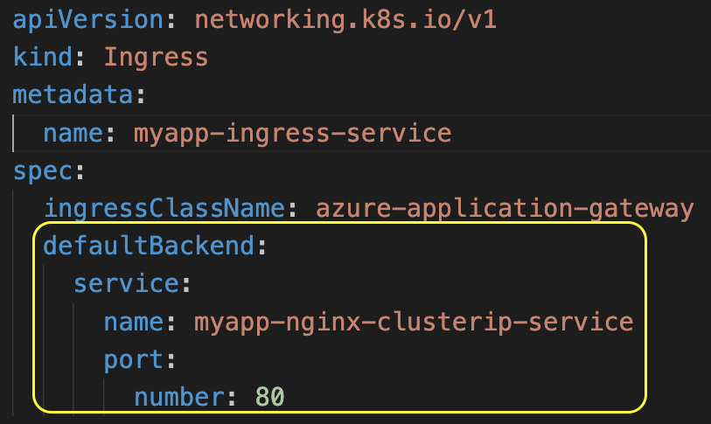
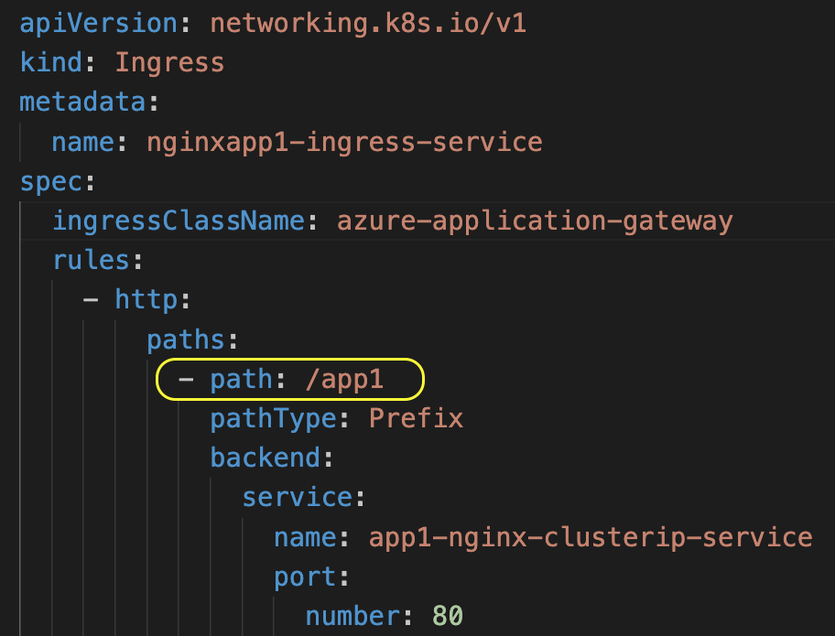
Azure AGIC - Ingress Health Probes
Usecase-1
Usecase-2
Uses default HTTP probe
Uses Custom HTTP Probe

Slide 93
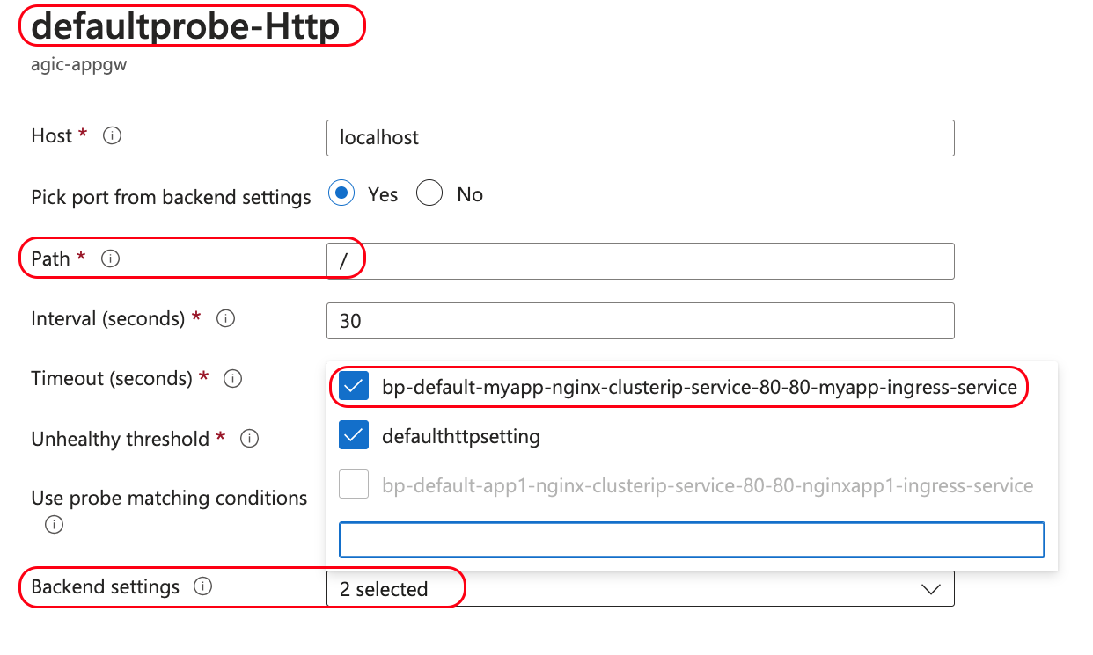
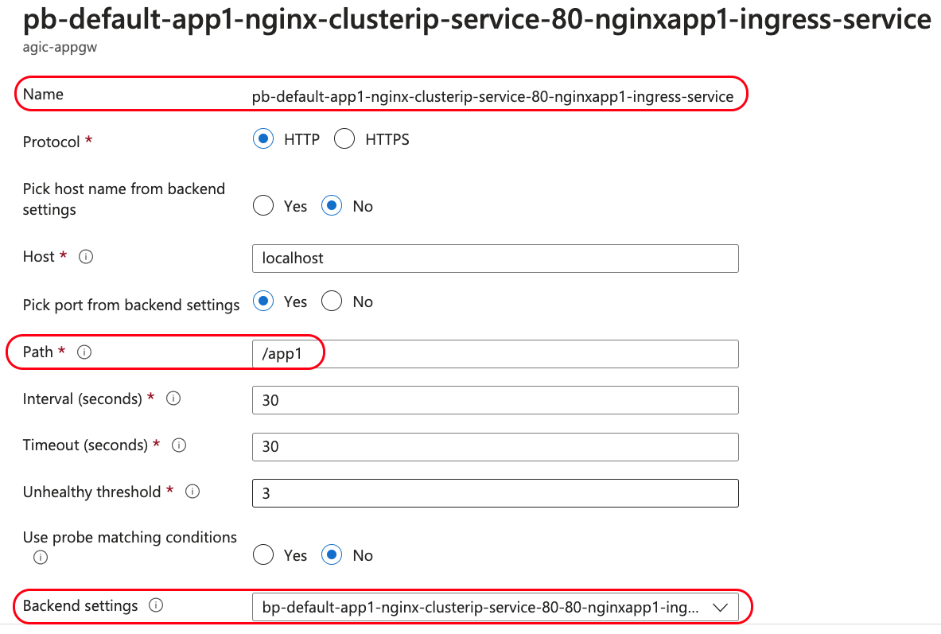
Azure AGIC - Ingress Health Probes
Usecase-1
Usecase-2

Slide 94
Demo-11
Azure AKS
AGIC
Annotations
Health Probes
Readiness and Liveness Probes

Slide 95
Health Probes
AGIC Health Probe Annotations defined in Ingress Resource
P
R
I
O
R
I
T
Y
O
R
D
E
R
HIGH
Health probes can determine if the configured backend target can serve requests.
Readiness Probe defined in Kubernetes Workloads (Pod, Deployment, StatefulSet)
AppGw won’t send incoming requests to the backend target if a configured health probe fails. Instead, it will respond to the request with an HTTP 502 Error.
Liveness Probe defined in Kubernetes Workloads (Pod, Deployment, StatefulSet)
If the health probe is successful, incoming requests will be forwarded to the backend target
AGIC defined fallback Health Probe
(default HTTP probe,
HTTP Path Probes)
LOW

Slide 96
Azure AGIC Ingress - Readiness Probe
Azure
Cloud
Virtual Network (10.224.0.0/12)
Users
Subnet: 10.225.0.0/16
Subnet: 10.224.0.0/16
AKS Cluster
Usecase-1
AppGW
Public IP
Custom HTTP Probe
Readiness Probe
/
App1
Application
Gateway
3
1
2
AGIC Ingress Controller
k8s API Server
Azure Resource
Manager

Slide 97
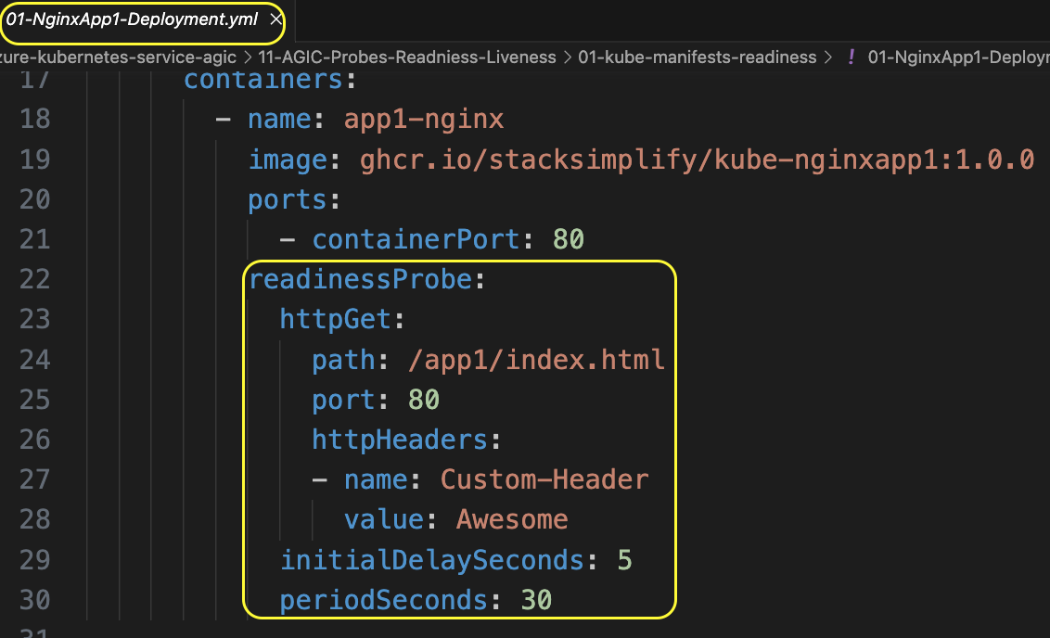
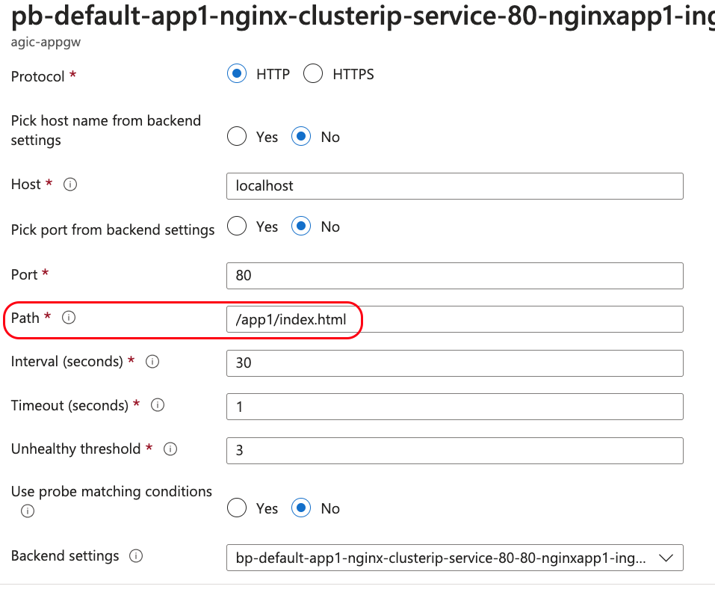
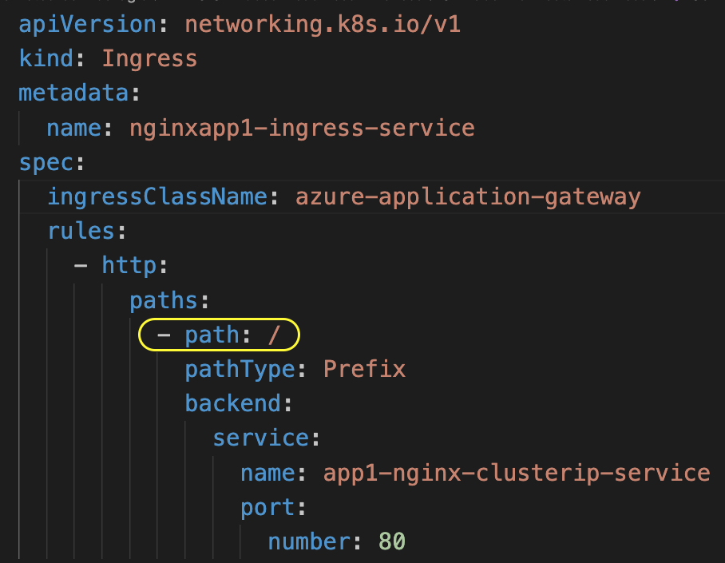
Azure AGIC Ingress - Readiness Probe
Usecase-1: Readiness Probe

Slide 98
Azure AGIC Ingress - Liveness Probe
Azure
Cloud
Virtual Network (10.224.0.0/12)
Users
Subnet: 10.225.0.0/16
Subnet: 10.224.0.0/16
AKS Cluster
Usecase-2
AppGW
Public IP
Custom HTTP Probe
Liveness Probe
/
App2
Application
Gateway
3
1
2
AGIC Ingress Controller
k8s API Server
Azure Resource
Manager

Slide 99
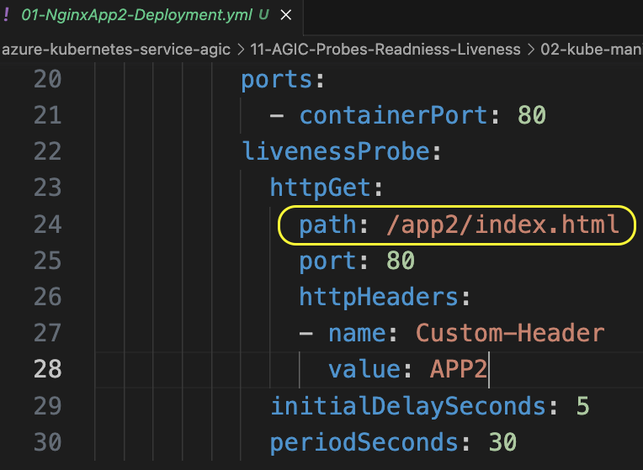
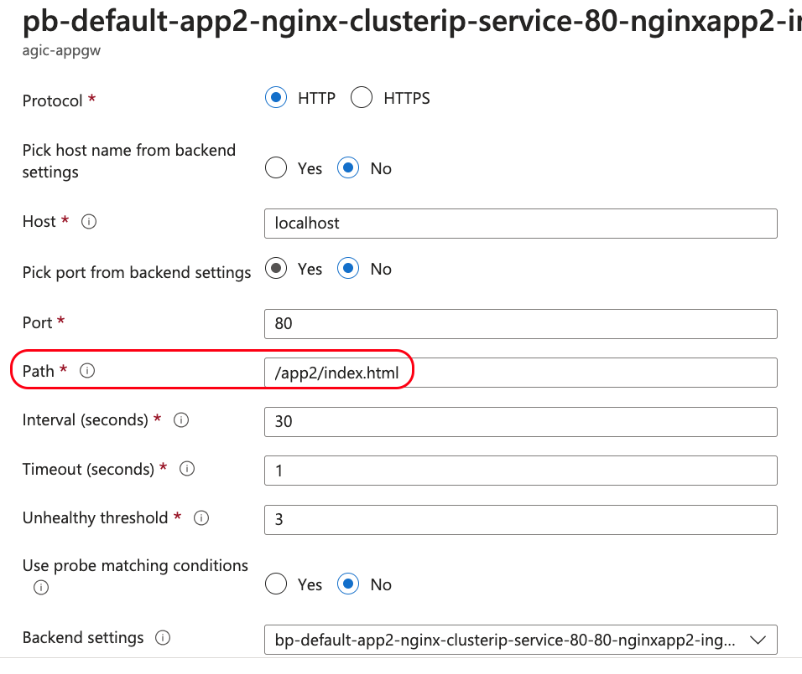
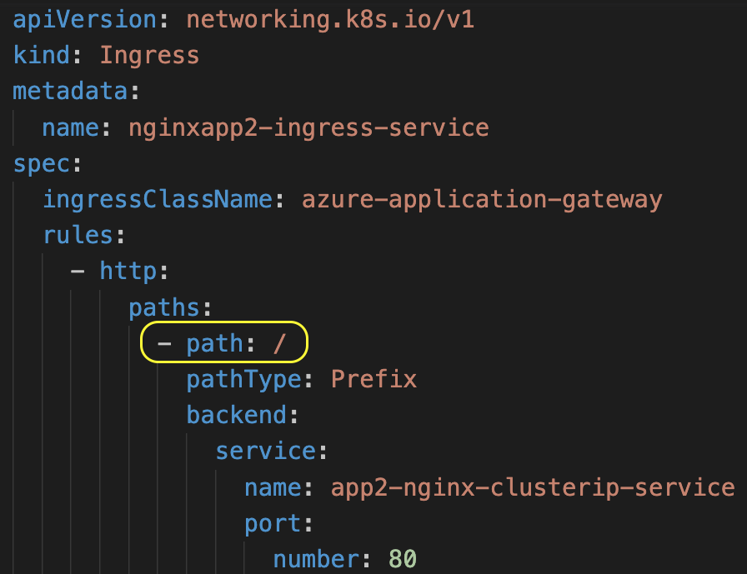
Azure AGIC Ingress - Liveness Probe
Usecase-2:
Liveness Probe

Slide 100
Azure AGIC Ingress - Readiness & Liveness Probes
Azure
Cloud
Virtual Network (10.224.0.0/12)
Users
Subnet: 10.225.0.0/16
Subnet: 10.224.0.0/16
AKS Cluster
When both probes are present which, one takes priority ?
Usecase-3
Readiness Probe
AppGW
Public IP
Custom HTTP Probe
Liveness Probe
/
App1
Application
Gateway
3
1
2
AGIC Ingress Controller
k8s API Server
Azure Resource
Manager

Slide 101
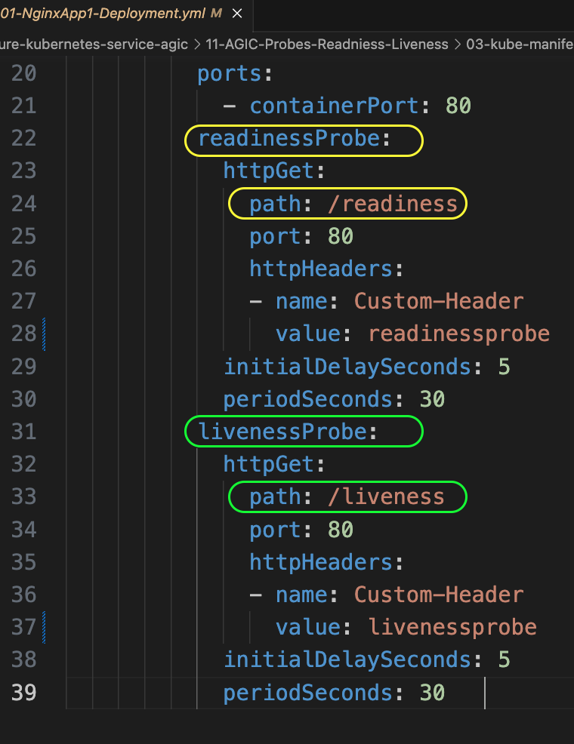
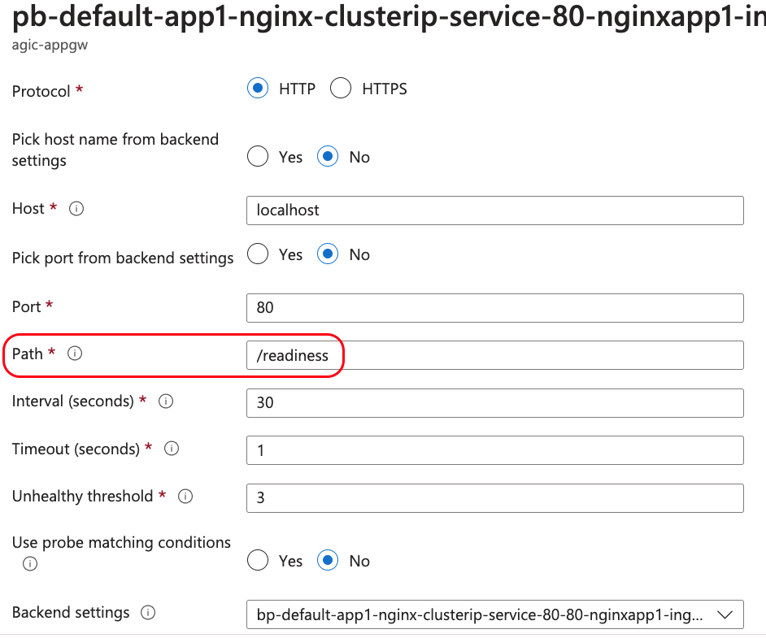
Azure AGIC Ingress - Readiness & Liveness Probes
Usecase-3:
Readiness and Liveness Probe
When both probes are used which, one takes priority ?

Slide 102
Demo-12
Azure AKS
AGIC
Annotations
Health Probe Ingress Annotations

Slide 103
Health Probes
AGIC Health Probe Annotations defined in Ingress Resource
P
R
I
O
R
I
T
Y
O
R
D
E
R
HIGH
Health probes can determine if the configured backend target can serve requests.
Readiness Probe defined in Kubernetes Workloads (Pod, Deployment, StatefulSet)
AppGw won’t send incoming requests to the backend target if a configured health probe fails. Instead, it will respond to the request with an HTTP 502 Error.
Liveness Probe defined in Kubernetes Workloads (Pod, Deployment, StatefulSet)
If the health probe is successful, incoming requests will be forwarded to the backend target
AGIC defined fallback Health Probe
(default HTTP probe,
HTTP Path Probes)
LOW

Slide 104
Azure AGIC Ingress - Health Probe Annotations
Azure
Cloud
Virtual Network (10.224.0.0/12)
Users
Subnet: 10.225.0.0/16
Subnet: 10.224.0.0/16
AKS Cluster
Azure AGIC Health Probe Annotations
AppGW
Public IP
Custom HTTP Probe
/
App1
Application
Gateway
3
1
2
AGIC Ingress Controller
k8s API Server
Azure Resource
Manager

Slide 105
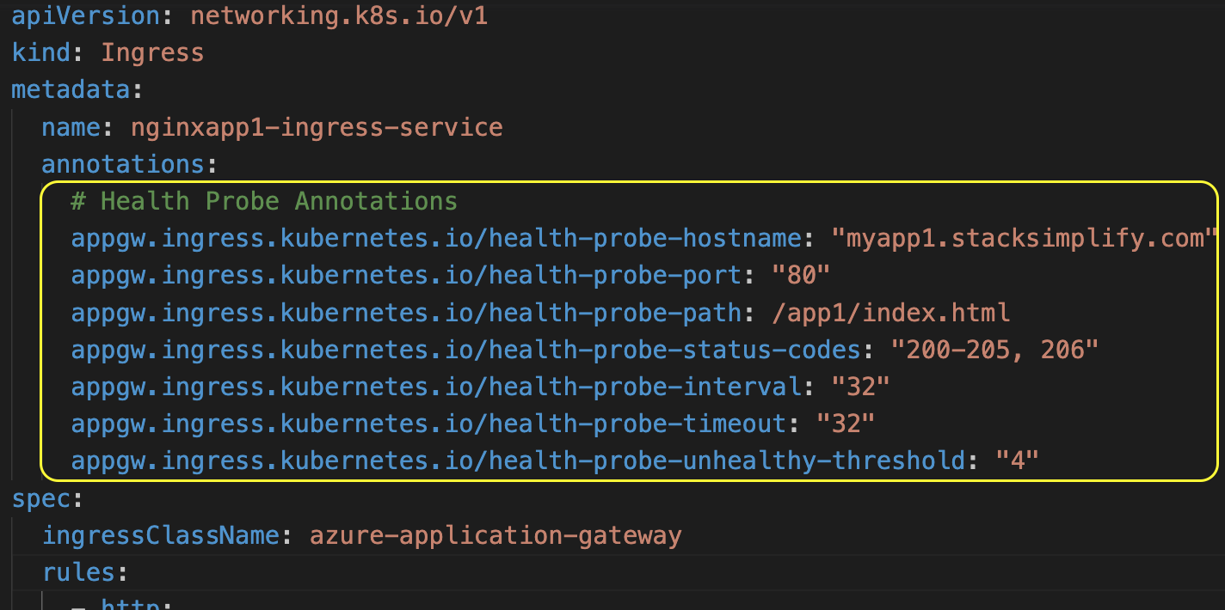
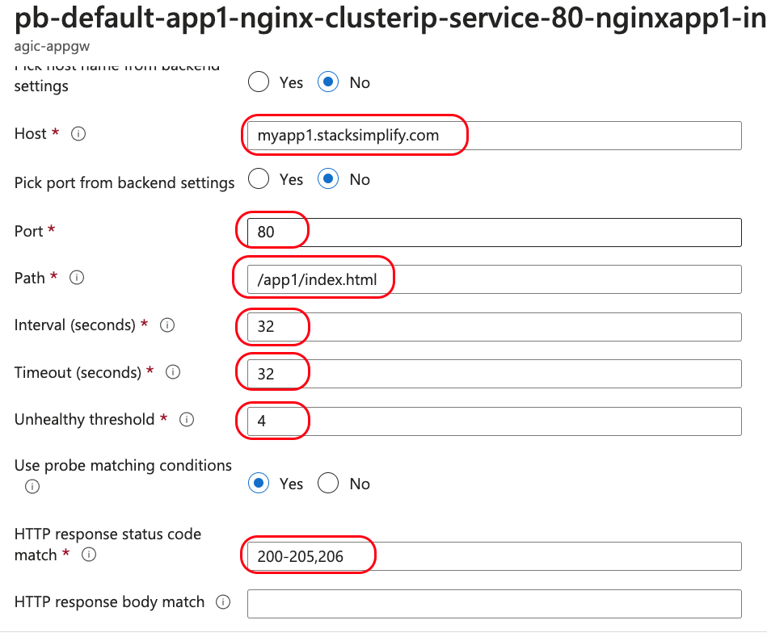
Azure AGIC Ingress - Health Probe Annotations
Values defined in Annotations match with Health Probe created
on Application Gateway

Slide 106
Demo-13
Azure AKS
AGIC
Delegate DNS Domain
AWS Route53 to Azure DNS Zones

Slide 107
Delegate Domain to Azure DNS
AWS Cloud
Azure Cloud
DNZ Zones
Domain Registrar
kubeoncloud.com
kubeoncloud.com
AWS Route53
Azure DNS Zones

Slide 108
Demo-14
Azure AKS
AGIC
External DNS Install

Slide 109
Azure AGIC Ingress - External DNS Install
Azure Cloud
Virtual Network (10.224.0.0/12)
Subnet: 10.225.0.0/16
Subnet: 10.224.0.0/16
Users
AKS Cluster
External DNS allows us to add / update / delete DNS Records in Azure DNS Zones declaratively from Ingress Service
AppGW Public IP
Application
Gateway
Azure Config File (azure.json)
DNS
Zones
External DNS
Managed
Service
Identity
AKS NodePool VMSS
AGIC Ingress Controller
k8s API Server
Azure Resource
Manager

Slide 110
Demo-15
Azure AKS
AGIC
Ingress + External DNS
Basic Demo

Slide 111
Azure AGIC Ingress - External DNS Basic
Azure Cloud
Virtual Network (10.224.0.0/12)
myapp1.kubeoncloud.com
Subnet: 10.225.0.0/16
Subnet: 10.224.0.0/16
Users
AKS Cluster
myapp1.kubeoncloud.com
AppGW Public IP
Application
Gateway
App1
DNS
Zones
HOST
(spec.rules.host)
Ingress Service
Managed
Service
Identity
AKS NodePool VMSS
External DNS
AGIC Ingress Controller
k8s API Server
Azure Resource
Manager

Slide 112
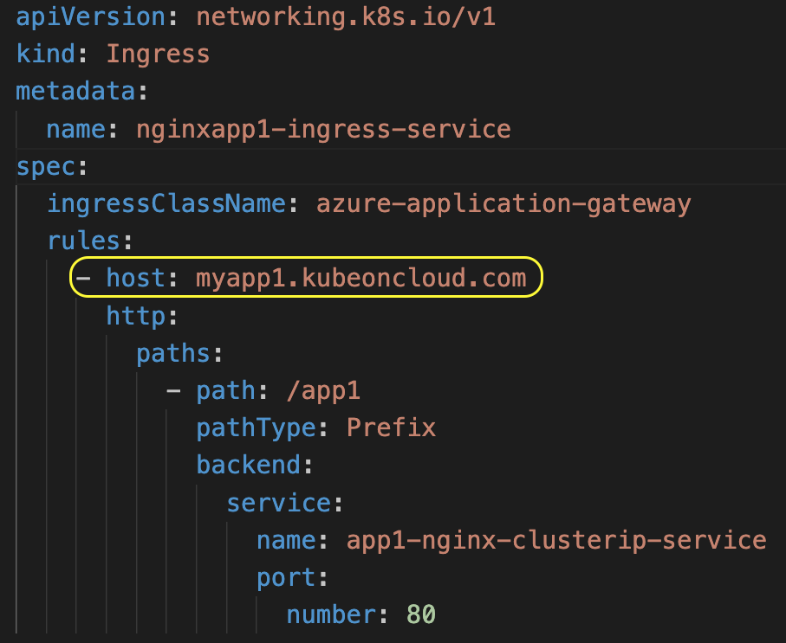
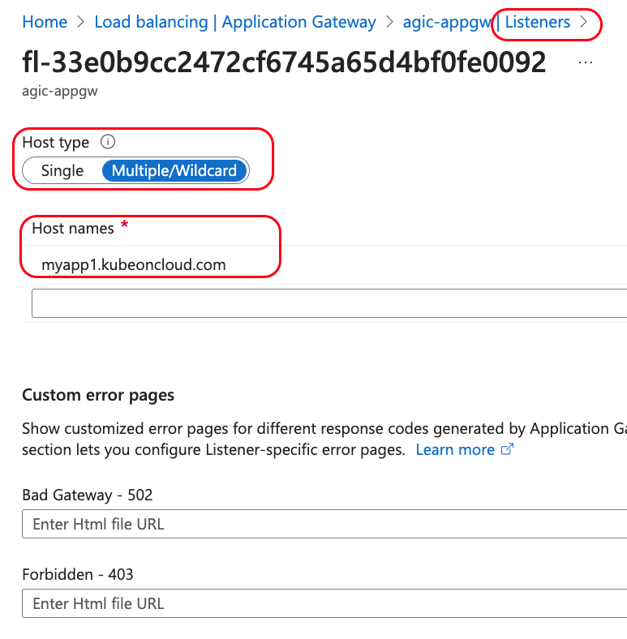
Azure AGIC Ingress - External DNS Basic
Application Gateway Listeners
This (spec.rules.host) adds DNS Record Set in Azure DNS Zones using k8s External DNS

Slide 113
Demo-16
Azure AKS
AGIC
Ingress + External DNS
Domain Name Routing

Slide 114
Azure AGIC - Ingress Domain Name Routing
Azure Cloud
Virtual Network (10.224.0.0/12)
eapp1.kubeoncloud.com
eapp2.kubeoncloud.com
Subnet: 10.225.0.0/16
Subnet: 10.224.0.0/16
eapp3.kubeoncloud.com
Users
AKS Cluster
eapp1.kubeoncloud.com
eapp2.kubeoncloud.com
App1
AppGW Public IP
Application
Gateway
eapp3.kubeoncloud.com
DNS
Zones
App2
Managed
Service
Identity
AKS NodePool VMSS
External DNS
App3
AGIC Ingress Controller
k8s API Server
Azure Resource
Manager

Slide 115
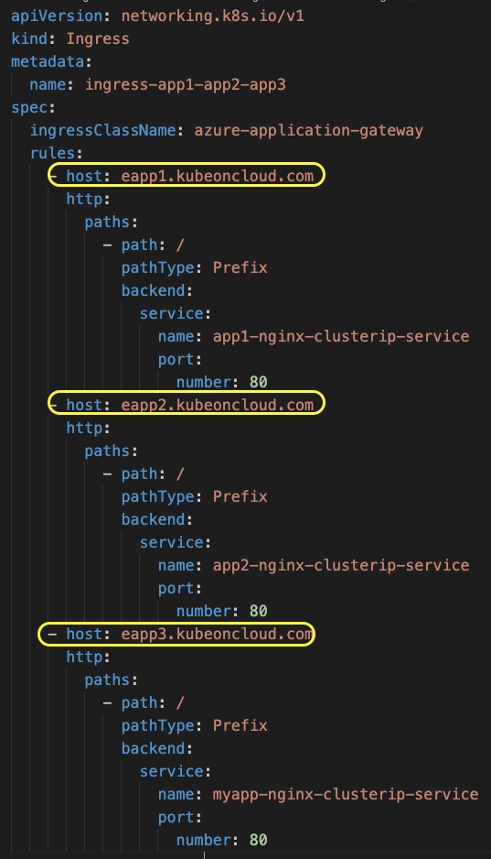
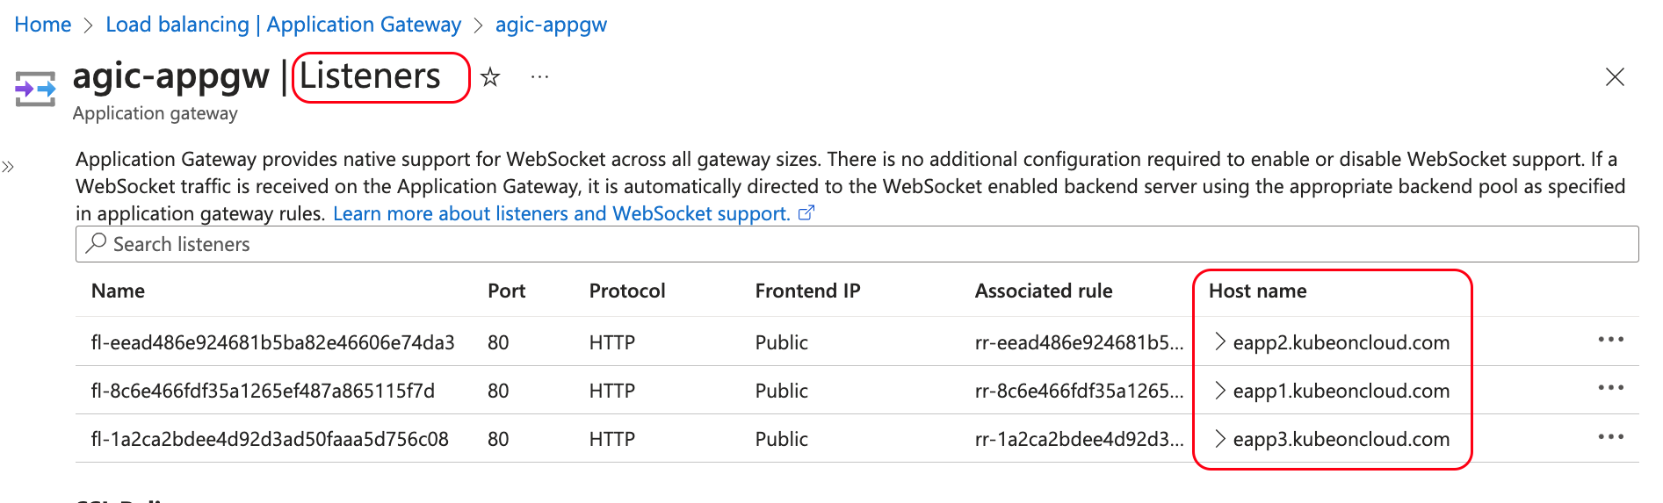
Azure AGIC - Ingress Domain Name Routing
In Application Gateway,
3 Listeners created based on 3 Domain Names defined in Ingress Service

Slide 116
Demo-17
Azure AKS
AGIC
Ingress + External DNS + SSL
Ingress TLS

Slide 117
Azure AGIC - Ingress SSL TLS
Azure Cloud
Virtual Network (10.224.0.0/12)
https://app1.kubeoncloud.com
Subnet: 10.225.0.0/16
Subnet: 10.224.0.0/16
Users
AKS Cluster
App1
app1.kubeoncloud.com
AppGW Public IP
Application
Gateway
TLS Certificate
DNS
Zones
SSL Cert
SSL Key
K8s Secret
Managed
Service
Identity
TLS
(spec.tls.secretName)
External DNS
Ingress Service
AKS NodePool VMSS
AGIC Ingress Controller
k8s API Server
Azure Resource
Manager

Slide 118


Azure AGIC - Ingress SSL TLS
As soon as Ingress Service is deployed, automatically SSL Certificate and Key present in k8s secret will be uploaded to Application Gateway

Slide 119


Azure AGIC - Ingress SSL TLS
When TLS enabled in Ingress Service
In AppGW,
these Listener settings will be applied

Slide 120
Demo-18
Azure AKS
AGIC
Ingress + External DNS + SSL
Ingress TLS + SSL Redirect (HTTP to HTTPS)

Slide 121
Azure AGIC - Ingress SSL TLS
Azure Cloud
Virtual Network (10.224.0.0/12)
appgw.ingress.kubernetes.io/ssl-redirect: "true"
http://app1.kubeoncloud.com
HTTP -> HTTPS
Subnet: 10.225.0.0/16
Subnet: 10.224.0.0/16
Users
AKS Cluster
App1
app1.kubeoncloud.com
AppGW Public IP
Application
Gateway
TLS Certificate
DNS
Zones
SSL Cert
SSL Key
K8s Secret
Managed
Service
Identity
TLS
(spec.tls.secretName)
External DNS
Ingress Service
AKS NodePool VMSS
AGIC Ingress Controller
k8s API Server
Azure Resource
Manager

Slide 122


Azure AGIC - Ingress SSL TLS + SSL Redirect
When ssl-redirect Annotation enabled in Ingress Service, Listener with Port 80 will be created in Application Gateway

Slide 123

Azure AGIC - Ingress SSL TLS + SSL Redirect
Rule will be created for Port 80 Listener where Permanent Redirection is enabled

Slide 124
Demo-19
Azure AKS
AGIC
Ingress + External DNS + SSL
Upload SSL Certs to Application Gateway
Reference AppGw Certs in Ingress Service

Slide 125
Azure AGIC - Ingress SSL + SSL Upload to AppGw
Azure Cloud
Virtual Network (10.224.0.0/12)
https://app2.kubeoncloud.com
HTTP -> HTTPS
Subnet: 10.225.0.0/16
Subnet: 10.224.0.0/16
Users
AKS Cluster
App2
app2.kubeoncloud.com
AppGW Public IP
Application
Gateway
TLS Certificate
appgw.ingress.kubernetes.io/appgw-ssl-certificate: "app2sslcert"
DNS
Zones
SSL Manual Upload to AppGw
appgw.ingress.kubernetes.io/ssl-redirect: "true"
SSL PFX
SSL Cert
Managed
Service
Identity
SSL Key
AKS NodePool VMSS
External DNS
AGIC Ingress Controller
k8s API Server
Azure Resource
Manager

Slide 126

Azure AGIC - Ingress SSL + SSL Upload to AppGw
Reference SSL Certificate uploaded to AppGw using appgw-ssl-certificate Annotation

Slide 127


Azure AGIC - Ingress SSL + SSL Upload to AppGw

Slide 128
Demo-20
Azure AKS
AGIC
Ingress + External DNS + E2E SSL
Build Backend SSL Application

Slide 129
Azure AGIC Ingress E2E SSL - Build Backend SSL App
Azure Cloud
Virtual Network (10.224.0.0/12)
https://PUBLIC-IP
Subnet: 10.225.0.0/16
Subnet: 10.224.0.0/16
Users
AKS Cluster
HTTPS
LB Public IP
HTTPS
Backend SSL
SSL Cert
SSL Key
Backend
K8s Secret
MyApp
Azure
Load Balancer

Slide 130

Azure AGIC Ingress E2E SSL - Build Backend SSL App
Nginx Config File using Kubernetes ConfigMap

Slide 131


Azure AGIC Ingress E2E SSL - Build Backend SSL App
Kubernetes Deployment

Slide 132
Demo-21
Azure AKS
AGIC
Ingress + External DNS + E2E SSL
Implement E2E SSL

Slide 133
Azure AGIC - Ingress E2E SSL
Azure Cloud
Virtual Network (10.224.0.0/12)
https://frontend.kubeoncloud.com
HTTP -> HTTPS
Subnet: 10.225.0.0/16
Subnet: 10.224.0.0/16
Users
AKS Cluster
frontend.kubeoncloud.com
AppGW Public IP
Application
Gateway
Frontend Cert and Key
HTTPS
Backend Cert or Root Cert
Backend SSL
Frontend SSL
DNS
Zones
SSL Cert
SSL Cert
SSL Key
Backend
K8s Secret
Frontend
K8s Secret
SSL Key
MyApp
Managed
Service
Identity
AKS NodePool VMSS
External DNS
AGIC Ingress Controller
k8s API Server
Azure Resource
Manager

Slide 134

Azure AGIC Ingress E2E SSL
Backend Annotations for E2E SSL
Frontend SSL Certificate using Ingress TLS
Backend Application Port is 443

Slide 135


Azure AGIC - Ingress E2E SSL
Backend Settings

Slide 136


Azure AGIC - Ingress E2E SSL
Frontend Listeners

Slide 137
Demo-22
Azure AKS
AGIC
Ingress + External DNS + SSL
Cert Manager + Lets Encrypt
Automatic Generation of Real and
Free SSL Certs

Slide 138
Azure AGIC - Ingress SSL with Let's Encrypt
Azure Cloud
https://sapp1.kubeoncloud.com
Virtual Network (10.224.0.0/12)
cert-manager.io/cluster-issuer: letsencrypt
https://sapp2.kubeoncloud.com
Subnet: 10.225.0.0/16
Subnet: 10.224.0.0/16
Users
AKS
Cluster
HTTP -> HTTPS
sapp1.kubeoncloud.com
SSL Cert
sapp2.kubeoncloud.com
SSL Key
sapp1 SSL cert
App1
sapp1
AppGW Public IP
Application
Gateway
Auto-Generated
L
E
T
S
ENCR
y
P
T
sapp2 SSL cert
DNS
Zones
SSL Cert
SSL Key
App2
sapp2
Managed
Service
Identity
AKS NodePool VMSS
External DNS
Cert-Manager
AGIC Ingress Controller
k8s API Server
Azure Resource
Manager

Slide 139


Azure AGIC - Ingress SSL with Let's Encrypt
Lets Encrypt SSL certificates created and uploaded to AppGw

Slide 140
Demo-24
Azure AKS
AGIC
Ingress + WAF
Enable WAF on Application Gateway
WAF Default OWASP Policies

Slide 141
Azure AGIC - Ingress + Enable WAF on AppGw
Azure Cloud
Virtual Network (10.224.0.0/12)
http://myapp1.kubeoncloud.com
Subnet: 10.225.0.0/16
Subnet: 10.224.0.0/16
Users
Application Gateway
AKS Cluster
MyApp
myapp1.kubeoncloud.com
AppGW Public IP
Default
OWASP
Policies
WAF
AGIC Ingress Controller
k8s API Server
Azure Resource
Manager

Slide 142
Demo-24
Azure AKS
AGIC
Ingress + WAF
Enable WAF on Application Gateway
WAF Custom Policy

Slide 143
Azure AGIC - Ingress + WAF Custom Policy
Azure Cloud
Virtual Network (10.224.0.0/12)
http://myapp1.kubeoncloud.com
Subnet: 10.225.0.0/16
Subnet: 10.224.0.0/16
Users
Application Gateway
AKS Cluster
MyApp
myapp1.kubeoncloud.com
AppGW Public IP
Default
OWASP
Policies
appgw.ingress.kubernetes.io/waf-policy-for-path: WAF-RESOURCE-ID
WAF
WAF Custom Policy
AGIC Ingress Controller
k8s API Server
Azure Resource
Manager

Slide 144

Azure AGIC - Ingress + WAF Custom Policy
WAF Custom Rule that will be block the traffic from specific IP or IP Range

Slide 145


Azure AGIC - Ingress + WAF Custom Policy
Usecase-1: Scope is Route Path (/app1) to which WAF Policy is enabled

Slide 146


Azure AGIC - Ingress + WAF Custom Policy
Usecase-2: Scope is Listener (/) to which WAF Policy is enabled

Slide 147
Demo-25
Azure AKS
AGIC
Ingress
Private IP Annotation

Slide 148
Azure AGIC - Ingress Private IP
Azure Cloud
Virtual Network (10.224.0.0/12)
Subnet: 10.225.0.0/16
Subnet: 10.224.0.0/16
AKS Cluster
Test User
curl http://private-ip
curl pod
Application Gateway
appgw.ingress.kubernetes.io/use-private-ip: "true"
Private IP
/
AppGW Public IP
Echo Server
AGIC Ingress Controller
k8s API Server
Azure Resource
Manager

Slide 149


Azure AGIC Ingress Private IP
In the Ingress Service, when Private IP enabled, Listener will be associated to Private IP in Application Gateway

Slide 150
Demo-26
Azure AKS
AGIC
Multiple Ingress Controllers
AGIC + Nginx Ingress Class

Slide 151
Azure AGIC - Multiple Ingress Controllers
Azure Cloud
Virtual Network (10.224.0.0/12)
Subnet: 10.225.0.0/16
Subnet: 10.224.0.0/16
AKS Cluster
Azure Load Balancer
LB Public IP
NGINX Ingress Controller
App1
Application Gateway
Users
/
App2
AppGW Public IP
AGIC Ingress Controller
k8s API Server
Azure Resource
Manager

Slide 152


Azure AGIC - Multiple Ingress Controllers
Ingress Class Names
NGINXIC
AGIC

Slide 153
Demo-27
Azure AKS
AGIC
Install AGIC using Helm

Slide 154
Azure Application Gateway Ingress Controller install using Helm
Azure
Cloud
Virtual Network (10.224.0.0/12)
Subnet: 10.225.0.0/16
Subnet: 10.224.0.0/16
AKS Cluster
AppGW
Public IP
3
Application
Gateway
2
1
Azure Resource
Manager
AGIC Ingress Controller
k8s API Server

Slide 155
Demo-28
Azure AKS
AGIC
Shared Application Gateway

Slide 156
Azure AGIC - Shared Application Gateway
Azure Cloud
Virtual Network (10.224.0.0/12)
Subnet: 10.225.0.0/16
myaciapp1
myaciapp1.kubeoncloud.com
myaciapp2.kubeoncloud.com
Users
myaciapp2
AppGW Public IP
/
Subnet: 10.224.0.0/16
Application
Gateway
AKS Cluster
App1
AGIC Ingress Controller
k8s API Server
Azure Resource
Manager

Slide 157
Demo-29
Azure AKS
AGIC
Watch Namespaces

Slide 158
Azure AGIC - Watch Namespaces
Azure
Cloud
Virtual Network (10.224.0.0/12)
Watch All Namespaces
Users
Subnet: 10.225.0.0/16
Subnet: 10.224.0.0/16
AKS Cluster
Namespace: Staging
AppGW
Public IP
App1
/app1
Namespace: Production
/app2
Application
Gateway
App2
3
2
1
AGIC Ingress Controller
k8s API Server
Azure Resource
Manager

Slide 159
Azure AGIC - Watch Namespaces
Azure
Cloud
Virtual Network (10.224.0.0/12)
Watch Prod Namespace
Users
Subnet: 10.225.0.0/16
Subnet: 10.224.0.0/16
AKS Cluster
Namespace: Staging
AppGW
Public IP
App1
Namespace: Production
/app2
Application
Gateway
App2
3
2
1
AGIC Ingress Controller
k8s API Server
Azure Resource
Manager

Slide 160

Azure AGIC - Watch Namespaces

Slide 161
THANK YOU

